Slide 1
IEEC 2023 Surrey Accessibility Guide
This guide has been created in order to enable everyone to enjoy and participate in our event to the fullest extent possible.
This guide has been carefully curated to ensure that delegates and others involved in the conference can navigate, engage, and experience the event with comfort and confidence.
In line with our commitment to inclusivity, we've taken proactive steps to create an environment that welcomes everyone and we believe that beyond the space, all of us including delegates attending the conference play a vital role in fostering an atmosphere of respect, understanding, and equal access.
Thank you for joining us in making the IEEC 2023 at University of Surrey a space where diversity is celebrated, and all attendees will have a great experience.
If you have any accessibility questions please contact k.mack@surrey.ac.uk

Slide 2
Housekeeping
Lighting
Please feel free to attend the event in clothing you are comfortable in
Please take comfort breaks when needed throughout the day
No fire drill is planned for the event. If the fire alarm sounds, please make your way to the assembly point - the Fire Assembly point for Rik Medlik building is on the piazza area which is the large open space out the front of the building where the statue is
Rik Medlik ground, first and second floor are fully glazed and therefore encounter bright sunlight throughout the building. Please see floor plans below for further information and locations
There will be presentations shown on the screens during the event however there will be no flash photography

Slide 3
Sound and space
The entrance and foyer areas will be busy and noisy due to the 250+ guests expected
The main lecture theatre where panel sessions and keynotes is equipped with the Sennheiser Mobile Connect Assistive Listening System
Speakers will either speak at a lectern microphone or with lapel mic during plenary and panel discussions
We ask visitors to remain quiet throughout the plenary and panel sessions
A designated quiet room with one table and seating for up to 10 people is available on the 1st floor – 01MS02 (turn left at the top of the stairs)
Guests can also go to the lake for some peace and quiet. Please note that we have some friendly campus geese who live on the lake so they may be nearby
Lunch will be served in the foyer area which will be busy at this time; delegates can eat in the restaurant area for a little more space or take their lunch outside if they prefer to have much more space

Slide 4
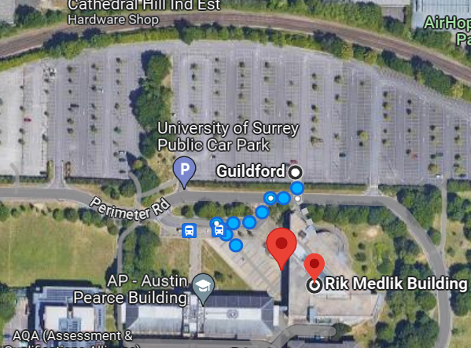
Physical access
Rik Medlik is a short walk from the Main Car Park, approx. 90m from the closest area of parking. Enter the car park, drive to the bottom, turn right and drive along to the section highlighted in the map, approximately 3 rows after the tree section and sectioned-off parking area (see map)
The building has a ramped entrance and is equipped with accessible lifts to all areas of the event.
03MS01 accessible entrance is located outside of the building – please inform a member of staff who will be able to assist

Slide 5
Toilet facilities
Floor plans below show locations of accessible toilets, lifts and baby changing facilities
There are toilets on each floor within easy reach of each parallel session room
There is unfortunately no hoist equipment available
The toilets are gender-specific (men's or women's)​
The toilet cubicles are laid out in rows of 10 with a shared area with sinks, hand driers and mirrors
Please also see our Parents' Guide for information about feeding and pumping on campus and other considerations for parents

Slide 6
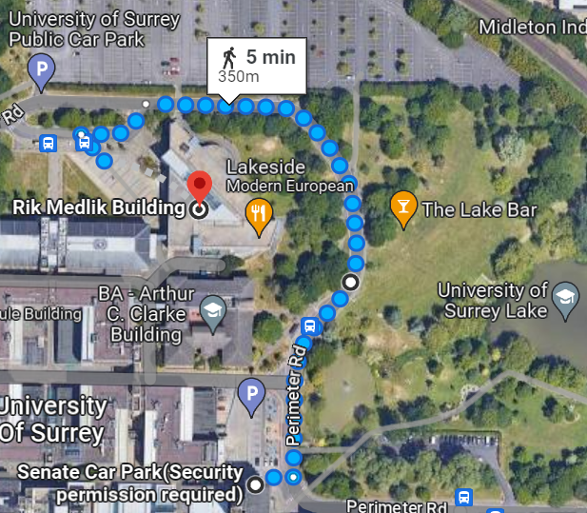
Health & Safety
The closest AED machine to the Rik Medlik building is located at Senate House (on the ground floor, control room) mobile with security and phone extension is 3333 or 01483 68 3333
Its position in relation to the conference areas of Rik Medlik building and the lake is shown on the map
Please report any first aid assistance required to Security who will be able to assist and who liaise with the emergency services where required
First Aid calls should go through 01483 683333 for emergencies or 01483 682002 for non-emergency

Slide 7
The University of Surrey is partnered with AccessAble. An online platform to help visitors to get to and around our sites and buildings at the University. For further information please visit our website: Accessibility information | University of Surrey

Slide 8
RIK MEDLIK BUILDING
GROUND FLOOR
Lakeside Coffee Shop Outdoor Terrace
03MS01
Accessible entrance outside of building
Key:
Glazing (sunlight)
Accessible Toilets and Changing Facilities
Assistive Listening
Lakeside Coffee Shop
8am – 3pm
Entrance
Main Event Room
03MS01 – Noisy area
Main Entrance
Accessible
Registration
Plenary & Panel Sessions
03MS01
Exhibitors
Business Lounge
34MS01
Luggage Room 13MS01
Parallel Session
Track 1
33MS01
Lifts
Other Offices
Catering
Toilets
Parallel Session
Track 2
32MS01
Other Offices
Business Lounge & Pop-up
Coffee Shop
Lakeside Restaurant
Other Offices

Slide 9
RIK MEDLIK BUILDING
FIRST FLOOR
Key:
Accessible Toilets and Changing Facilities
Room 01 MS 02
Quiet Room
Other Offices
Quiet Room
01 MS 02
Other Offices
Parallel Session
Track 5
80MS02
Lifts
Toilets
Parallel Session
Track 4
81MS02
Parallel Session
Track 3
39MS02
Other Offices

Slide 10
RIK MEDLIK BUILDING
SECOND FLOOR
Key:
Accessible Toilets and Changing Facilities
Hackathon
66M503
Hackathon
Breakout Space
69MS03
Other Offices
Other Offices
Parallel Session
Track 6a
72MS03
Lifts
Toilets
Parallel Session
Track 6b
32MS03
Other Offices
Other Offices

