Slide 1
Neil
Col
Neil
Col
Enterprise and entrepreneurship education: Rapping it 26/10
or … the A to Z of supporting Diversity in EE .... Plus the Top 10 that stuff it up
1
of 20

Slide 2
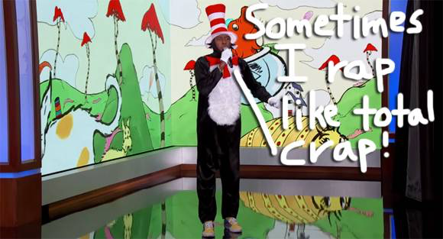
Da Rules of da Rhyme
2
of 20

Slide 3
Accompany Academic development and Admit the armed forces (on their return)
Big up the Baby Boomers and Bring in the Baldies (recently sacked and looking for more bankroll)
3
of 20

Slide 4
Champion Contextual appreciation and call in da Couch potatoes
Disrupt the status quo and Deliver da Dreamers to meeeee
4
of 20

Slide 5
Educate the Educators and Entertain da Engineers
Focus on Failure and Flush out da Frustrated Faculty peeps
5
of 20

Slide 6
Guides guides and guides (like QAA) to support development and Gather all all da grandmas
Highlight Heutagogical learning and Hook in da Hustlers
6
of 20

Slide 7
Idolize all the Ideas and Incubate da Intoxicated
Justify Judgment suspension and Jam da ideas
7
of 20

Slide 8
Knock da Knowledge, prefer da wisdom and Knead da K-12 cohorts
Liberate Lessons plans and Legislate Lean thinking
8
of 20

Slide 9
Me Mindful of Mental Health challenges and Me needs More Mamas
Nurture the Networks and Nobble da Nurses
9
of 20

Slide 10
Obliterate da Objectors and bring in all da Old men
Promote da Pracademics and Pull in da Polish
10
of 20

Slide 11
Quash the Quitters and Question the value of formal Qualifications
Revere the Role models and Reject the Rigid old schoolers
11
of 20

Slide 12
Suck up to Senior management and Satisfy all the Single ladies (with entrepreneurship education)
Transcend Traditional Teacher education and Tap into da Transgender Takeover
12
of 20

Slide 13
Underwrite new University-wide programs and Unsettle da settled
Venture into Virgin ideas Validating new Visions
13
of 20

Slide 14
Widen Access to our programs and Wheel in da wheelchairs
Generation X, X-Ray their lives
14
of 20

Slide 15
Get Generation Y mentors and Yank in da Young
Zero in on da needs of Generation Z
15
of 20

Slide 16
Lack of Stakeholder Buy in
Start-up Only Focus
16
of 20

Slide 17
Cultural Inequality
University Vision stuck in
da past
17
of 20

Slide 18
Gender Imbalance
Visa Conditions
18
of 20

Slide 19
Inadequate Resources
Recruitment Communications
19
of 20

Slide 20
Faculty Program Rules
Traditional Lecturer Formats
20
of 20

