Slide 1
We all have something to offer
1
of 20
Notes:
James Rizzi

Slide 2
2
of 20
Notes:
Within Academy of S&PA - enterprise

Slide 3
3
of 20
Notes:
Course design - academy-wide Challenging - opened up opportunities

Slide 4
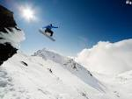
4
of 20

Slide 5
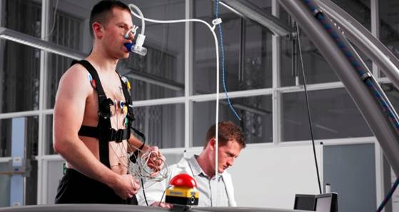
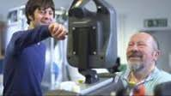
5
of 20

Slide 6
6
of 20

Slide 7
7
of 20

Slide 8
8
of 20
Notes:
Experiential learning - engaged

Slide 9
9
of 20
Notes:
True Reflection

Slide 10
10
of 20

Slide 11
11
of 20
Notes:
Working together

Slide 12
12
of 20
Notes:
Tasks to put under pressure

Slide 13
13
of 20

Slide 14
14
of 20

Slide 15
15
of 20

Slide 16
16
of 20
Notes:
Working together

Slide 17
17
of 20
Notes:
Dragons Den style assessment

Slide 18
18
of 20

Slide 19
19
of 20

Slide 20
20
of 20

