Slide 1
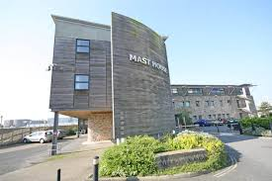
Extra-curricular enterprise activities-exploring the ‘missing perspective’
Dr Emily Beaumont, Sarah Preedy and Sarah Stevenson
Plymouth University
1
of 20
Notes:
Introduction
Title of study, where we are based.
Study supported by EEUK grant

Slide 2
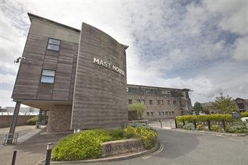
2
of 20
Notes:
Futures Entrepreneurship Centre
Teaching, Research, Consultancy in Entrepreneurship.

Slide 3
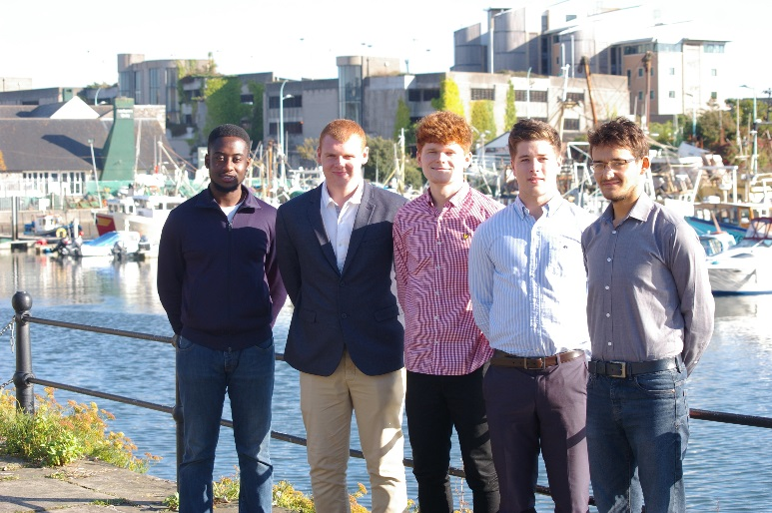
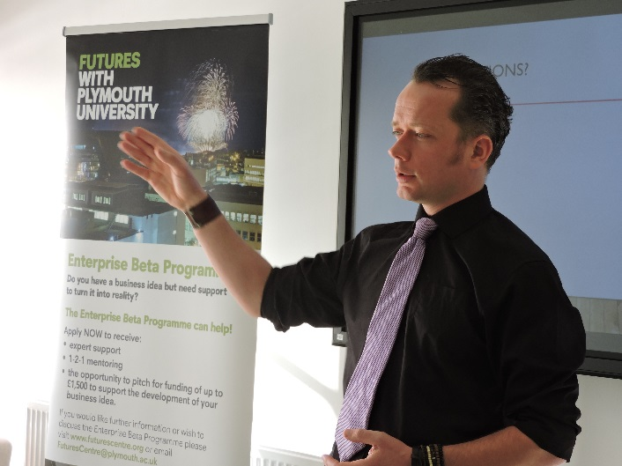
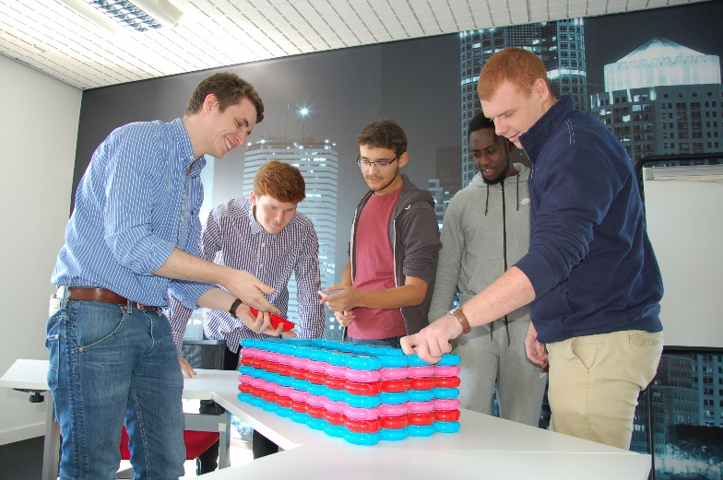
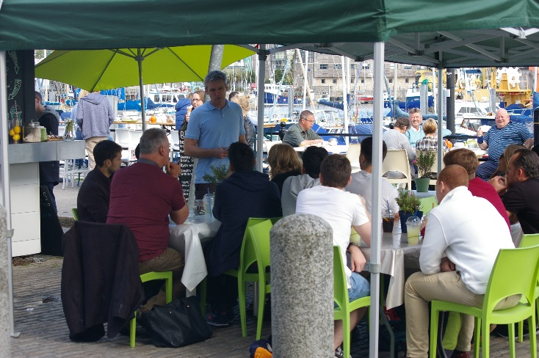
Extra-curricular Enterprise Activities
BETA Enterprise – FLUX – Talent Development Workshops – Social Storm Hackathon
3
of 20
Notes:
Value of Extracurricular enterprise activities
Extra-curricular enterprise activities have been recognised as valuable in supplementing in class learning and stimulating student’s enterprise knowledge, skills and experience (Edwards and Muir, 2005; Hannon, 2007; NIRAS, 2008). In acknowledgment of the value of extra-curricular enterprise activities many Higher Education Institutions (HEIs) have incorporated them into their wider extracurricular offer, in particular to focus on the practical component of enterprise education.
How we do this at Plymouth
Through the Futures Entrepreneurship Centre with activities such as BETA, FLUX, Talent Development Workshops, Social Storm Hackathon to name a few.

Slide 4
What is my entrepreneurial capability?
4
of 20
Notes:
This study explored students’ participation in extra-curricular enterprise activities from the student perspective, specifically focusing on which students participate in these activities, their expectations and outcomes, and the perceived impact of participating on their entrepreneurial behaviours, competencies and capabilities. This will be done by comparing these students to a control group made up of students from the same post 1992 institution, but not involved in extra-curricular enterprise activities. This paper intends to address the ‘missing perspective’ in enterprise education; the student.
This study chose to focus on the key stakeholder in Enterprise Education; the student. There are a limited number of studies focusing on extra-curricular enterprise activities (Jones and Hill, 2003 and Kuh, 1995) that take a similar approach, and these studies are somewhat ‘out-of-date’ when considering the changing HE environment and the changing status of enterprise in HE. As in research on the employability of HE students, students can be described as ‘the missing perspective’ (Tymon, 2011:9) with their opinion on current practice in extra-curricular enterprise education being unknown.

Slide 5
5
of 20
Notes:
Engagement in extra-curricular enterprise activities varies widely across institutions, as some students tend to prioritise activities that are being assessed (Rae et al., 2010; Lilischkis et al; 2015).
Government funding for enterprise activity, especially extracurricular activity, can be short-term and fragile (Hannon 2007; Rae et al., 2012).
Mapping occurrences of extracurricular enterprise activities is made difficult by potential over and under representation of activity (Penulua et al., 2012; Rae et al., 2012).
Responsibility for the coordination and tracking of enterprise support activities at HEIs may fall to a few key individuals rather than communicated across the whole institution thereby measurement of activity can depend upon which member of staff you consult (Hannon, 2007; Gibb, 2010, Rae et al., 2012; Preedy, 2014).
Comparing activity across multiple HEIs is problematic as each institution varies hugely in the scale and delivery of their activities (Matlay, 2006; Preedy, 2014; Lilischkis et al., 2015).

Slide 6
What behaviours and competencies do you think
you will develop through this activity?
How did this activity compare to your expectations for it?
What extra-curricular enterprise
activity did you just engage in?
What behaviours and competencies
do you think you developed through this activity?
'Entrepreneurial Capability' is defined as an ability to
recognise and exploit opportunities.
How do you rate your entrepreneurial capability
at this point in time?
What are your expectations for this activity?
6
of 20
Notes:
This study used an online survey method to conduct a pre and post evaluation of extra-curricular enterprise activities running at a post 1992 University in the 2015/16 academic year. Each survey contained both open and closed questions to provide quantitative and qualitative data. Each student was given a unique identifying number that enabled researchers to track students who engage in one or more extracurricular activities whilst ensuring anonymity. A control group of students that did not engage in extracurricular enterprise activities was also surveyed at the beginning and end of the academic year (2015/16) using a non-engagement survey.
When asking students questions regarding entrepreneurial competencies, they were presented with a list modelled on Morris et al’s (2013);

Slide 7
Opportunity exploitation
Alertness to opportunities
Interpersonal Skills
Self-efficacy
Effectual Reasoning
Resilience
Any others…(please state)
Networking
Perseverance
Leadership
Creativity
Increase in confidence
Tolerance of Ambiguity
Locus of control
Propensity to take risks
7
of 20
Notes:
When asking students questions regarding entrepreneurial competencies, they were presented with a list modelled on Morris et al’s (2013);
Following data collection, survey data was analysed qualitatively and quantitatively with the assistance of appropriate analysis tools (e.g. NVIVO and SPSS). In addition to exploring the data in relation to the stated research objectives, the purpose of the analysis was to draw out cross-cutting themes on which students participate in these activities, their expectations and outcomes, and the perceived impact of participating on their entrepreneurial behaviours, competencies and capabilities. A comparison was also made to a control group made up of students from the same post 1992 institution, but not involved in extra-curricular enterprise activities. Analysis also aimed to identify examples of good practice and areas of development in extracurricular enterprise activities.

Slide 8
 | Male | Female | Unknown/Other
Non-Engagement (Pre) | 27 (37.5%) | 44 (61.1%) | 1 (1.4%)
Non-Engagement (Post) | 14 (45.2%) | 16 (51.6%) | 1 (3.2%)
Enterprise Engagement (Pre) | 48 (40.3%) | 70 (58.8%) | 1 (0.8%)
Enterprise Engagement (Post) | 18 (30.5%) | 32 (54.2%) | 9 (15.3%)
8
of 20
Notes:
Female respondents outnumbered male respondents in every category. As around 56% of the total student body at this post 1992 University is female (2014-2015 Student Equality Data from the corporate information system), these figures are representative of the wider population, and in line with the closing gender gap amongst female entrepreneurs found by OECD Statistics Directorate (2015). However, it should be noted that there wasn’t gender parity within degree subtype. Female students were significantly more likely to be doing Tourism and Hospitality degrees, a sector that OECD (2015) recognises as being dominated by female entrepreneurs.
In terms of ethnicity, the demographics are more diverse than the overall demographics at this post 1992 University. Students from all ethnicities were present at the enterprise events and in the two datasets for non-engagement. The most recent figures for this post 1992 University (2014-2015 Student Equality Data) show that around 83% of the total student body is White (British or Other), and this largely holds true for the Non-Engagement groups. But in the Enterprise-Engagement (Pre) group, 78% of respondents identified as White British, with the second-largest category being Asian or Asian-British Chinese attendees and only the third-largest being Other White. This is a positive finding in terms of inclusivity. It indicates that enterprise events were slightly more inclusive to BME students. Another factor to note is the Faculties that student attendees mainly derive from.
It can be seen that the vast majority of respondents who attended entrepreneurship events were on programmes from the Faculty of Business. This situation is not unusual, as several studies have identified the concentration of enterprise activities both in programme and extracurricular, within business schools (Hannon et al., 2007; Carey and Matlay, 2011; Pittaway and Edwards, 2012). It is likely that students who are already learning about entrepreneurship in their regular lectures may be more likely to take an interest in extracurricular enterprise events. It also indicates that enterprise events appear to be primarily advertised to, or hold the most appeal for, persons doing these types of degrees. Students from other faculties appear not to see these events as relevant to their careers – although plenty of opportunities exist for arts-themed business start-ups.

Slide 9
Expectations of Extra-curricular Enterprise Activities
Category | Number of Respondents | Examples
Sustainability, social enterprise or community-focussed expectation | 26 | ‘information around enterprise/community projects’, ‘to better my understanding of sustainable business’, ‘a better understanding of social enterprises’
An expectation of primarily enjoyment networking or socializing | 9 | ‘fun’, ‘it would be funny’
An aim of gaining career or business skills | 24 | ‘to gain insight on how to do better presentations’, ‘develop insight to business world and life as an entrepreneur’
An expectation related to generalized skills or positive experiences | 47 | ‘knowledge’, ‘positive way of thinking’, ‘self-development’
No defined aim, or a negative expectation | 4 | ‘possibly frustration, but hopefully a pleasant surprise’, ‘open-minded- I’ll find out’
A primarily study-related expectation | 0 | N/A
9
of 20
Notes:
Enterprise Engagement students were asked about their expectations for the activity (Pre) and how the event lived up to their expectations (Post).
These results show that respondents consistently had very career-focussed expectations. Expectations were also consistently positive – students were optimistic about learning something new, even (as in a majority of cases) where they didn’t have a very specific idea of what this was. By far the most common reason given for attending events is related to generalized life skills or self-development – motivation, inspiration, knowledge, understanding etc. – not specific business skills. This suggests that attendees considered the events to be of wider value than just a how-to guide for a business start-up.
In the post-event data sets, students were asked how the activity compared to their expectations of it. 80% of students said that it matched their expectations, only 9% said that it differed from their expectations. The remaining percentage made random comments!

Slide 10
Expectations of extra-curricular activities (Non-enterprise)
Socializing, networking (e.g. ‘a wider social network of friends’, ‘building more networks’, ‘friends/ wider social life’, ‘spending time with like-minded people’)
Enjoyment and life skills (e.g. ‘fun’, ‘personal development’, ‘laughs’, ‘discipline’)
Health (e.g. ‘increased fitness’, ‘healthy life’, ‘relieve stress and keep fit and healthy’)
Career and business skills (e.g. ‘get some idea about opportunities after studies’, ‘additions to my CV and further experience and skills’, ‘qualifications in certificate form’)
Studies (e.g. ‘Network to gain further knowledge. Also like-minded people who may help with my own degree’)
Other (e.g. a spiritual or niche interest benefit, such as becoming more involved in a religion or improving at skiing)
10
of 20
Notes:
Students who did not attend enterprise events were asked instead a related question about any extracurricular activities they had done (non enterprise), and what their expectations were on the benefits gained from these. They were much more ‘life’ orientated in comparison to the enterprise group.
These students, surveyed at the end of the academic year, were asked about the reality of their expectations in terms of the perceived benefits. By comparison, answers tended more towards career, business and life skills and fewer answers proportionally seemed to cite socializing, health or enjoyment benefits as the primary aim. This time, the most common answers had themes of:
Life skills, enjoyment and altruism (e.g. ‘motivation and satisfaction that I have contributed to positive causes in society’, ‘learnt commitment and how to manage my money’)
Career and business skills (e.g. ‘leadership, teamwork, entrepreneurability (sic), creative thinking etc.’, ‘to gain advice from fellow entrepreneurs’)
Other (spiritual or niche interest benefit) (e.g. ‘I got better at archery’)

Slide 11
11
of 20
Notes:
Students in all four datasets were asked to identify which out of fifteen behaviours and competencies, based on those listed out by Morris et al. (2013) they expected to gain, and then which they perceived they actually gained. These tables illustrate the percentage of total respondents (in each category) who rated themselves as possessing a particular competency.

Slide 12
12
of 20
Notes:
For all competencies save ‘creativity’ those Enterprise Engagement students who saw improvement, often significant improvements as well. However, for control group students, ten of the fifteen competencies decreased, again several rather dramatically, while only five increased, and these only slightly.
For the Enterprise Engagement group, particularly large gains were seen in Resilience (7.1% to 44.8%) and Perseverance (13.4% to 58.6%). The only category where a decrease was seen over time was Creativity (34.8% to 20.7%). It is not clear why this happened, amidst so many other increases. The Non Engagement students became less sure of their competencies from Pre to Post, decreasing especially in Confidence and Creativity. This is clear evidence that students perceive their competence at entrepreneurship to increase significantly when they attend enterprise events to improve it.
One slight cautionary note in these findings could be the students’ own recognition of competencies. Volumes of education theory articles have been written on the difficulties students experience in recognising their own skills and in applying them in differing contexts – and this is known to impact on students’ understanding of concepts like ‘graduate attributes’ and ‘employability’ too. Likewise, experts in a field – entrepreneurship included - are known to perceive the skills and knowledge of their field differently to a novice (Chi et al., 2014).

Slide 13
13
of 20

Slide 14
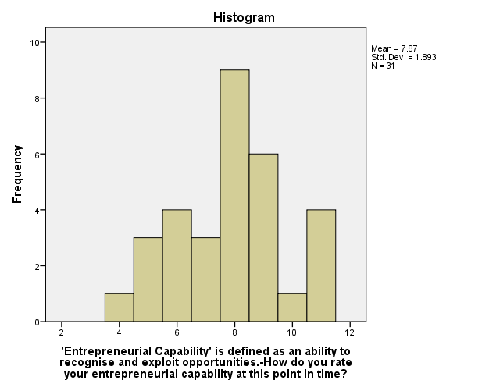
Non-Enterprise extra-curricular
engaged students
14
of 20
Notes:
Students from both groups were as to rate their entrepreneurial capability at the time the survey was taken. This value had the potential to change over time for each person, and as it was based on a subjective measure of self-confidence, it did not always increase in a linear way over time as an individual student attended more events. However, the aggregate scores are a useful measure of comparison. The scale was 0 -10 (represented on the graphs as 1- 11).
The mean rating of this group was 7.01, and a number of individuals rated themselves at the highest possible score, despite not doing business degrees or attending any enterprise events. Interestingly, the 9 students from this group who did no work, volunteering, study clubs or extracurricular activities of any kind tended to rate their entrepreneurial skills fairly highly (at 7,10, 4, 5, 3, 8, 8, 8 and 9).
The group showed improvement over time, as the mean rose from 7.01 (Pre) to 7.87 (Post). Fewer students also rated themselves in the lowest categories, in the Post survey.

Slide 15
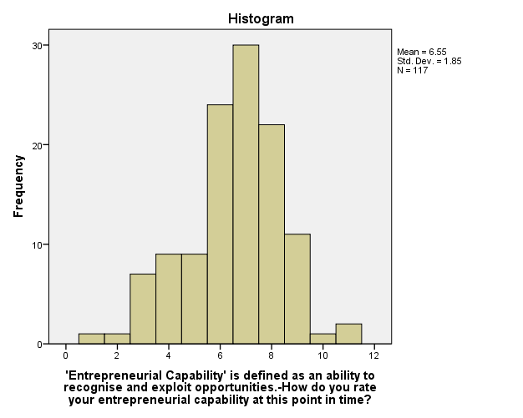
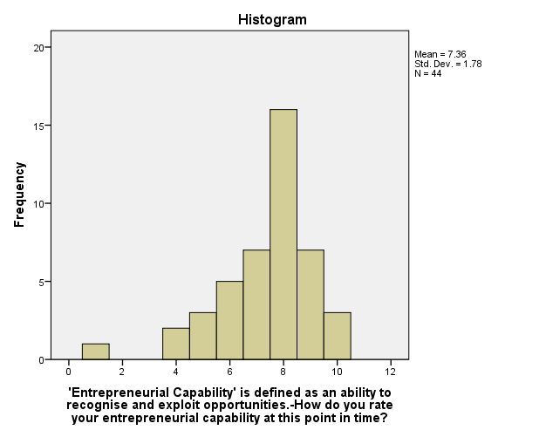
Extra-curricular Enterprise Activity
engaged students
15
of 20
Notes:
By comparison, the mean rating by Enterprise Engagement students (Pre) was actually lower than those who had no intention of going to one. The mean was 6.55 (shown in the diagram above), compared to 7.01. Several students have rated themselves in the lowest categories, and very few have rated themselves in the highest. One sociological explanation is that students are comfortable giving lower self-ratings if it’s immediately before they feel this self-rating will be improved anyway. Alternatively, they may have an unrealistically low self-perception, or a better understanding that business entrepreneurship skills take work to acquire.
The mean improved between Enterprise Engagement students’ Pre and Post, from 6.55 to 7.36. This shows that students’ perception of their entrepreneurial capabilities was improved by attending enterprise events. However, the group of Non-engagement students still rated themselves more highly than the Enterprise Engagement students (7.87 vs 7.36).

Slide 16
Preliminary Conclusions…
16
of 20
Notes:
In conclusion this study has shown that students engaged in extra-curricular enterprise activities are likely to be female, studying a programme within the Faculty of Business and in the second or final stages of their programme. Enterprise Engaged students had very career-focussed expectations of the extra-curricular enterprise activities they engaged in, which they perceived were met on completion. In comparison, the non-engagement group’s expectations around extra-curricular activities that they engaged in were more related to socializing, generalized life skills or physical fitness. Similar to their expectations for extra-curricular enterprise activities, Enterprise Engagement students highlighted a career-focus and transferrable skills/knowledge as perceived outcomes of engagement. Enterprise Engagement students saw improvements from Pre to Post in their rating of all competencies, save ‘creativity’. However, Non engagement students saw a decrease in ten of the fifteen competencies, several rather dramatically highlighting the significance in improving entrepreneurial capabilities though engagement in extra-curricular enterprise activities. Finally, the mean rating of entrepreneurial capability improved between Enterprise Engagement students’ Pre and Post evaluation. However, Non-engagement students still rated themselves more highly than the Enterprise Engagement students (7.87 vs 7.36). However, enterprise students started at a lower self-perceived rating of entrepreneurial capability and increased much more. Given that several Non-engagement students rated themselves very highly in both cases, this may point to a more realistic view, before and after, amongst students drawn to enterprise activities, as well as a greater overall impact of the enterprise events. After all, if they are engaged in enterprise activities, they perhaps have a better understanding of entrepreneurial capability, leading to a more realistic, be it lower, rating.

Slide 17
Further Research…
17
of 20
Notes:
We are going to continue this survey again this year for PU students.
There are several further areas to explore in this developing research area. Previous literature and this study focus on single institutions and therefore, going forward, a multi-institutional study, allowing comparisons across the HE sector, would be advantageous. A qualitative methodology would also allow for a deeper exploration of students’ perceptions and understandings of their competencies. The inclusion of interviews with enterprise educators would also provide a comparison between intended delivery (by enterprise educators) and perceived impact (on the students).

Slide 18
Implications for Practice…
18
of 20
Notes:
This study concludes that enterprise educators need to be sensitive in the design and development of their extra-curricular enterprise activities to address specifically identified entrepreneurial behaviours and competencies to have a greater impact on students’ entrepreneurial capability.
We need to recognise and enable students to recognise where they are developing/building upon these entrepreneurial capabilities, behaviours and competencies.
How can we do that…student compass is a way Plymouth is starting to consider that...but we would like to work on this with you all so...

Slide 19
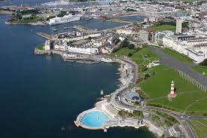
Extra-Curricular Enterprise Activity Workshop Day
Friday 21st October 2016
At Plymouth University
For more information speak or email me at emily.beaumont@plymouth.ac.uk
19
of 20
Notes:
You are invited to join us in sunny Plymouth for a workshop.

Slide 20
Key References
Abreu, M. and Grinevich, V. (2013), ‘The nature of academic entrepreneurship in the UK: Widening the focus on entrepreneurial activities’, Research Policy, Vol. 42,No. 2, pp. 408 – 422.
http://sephe.eu/fileadmin/sephe/documents/sephe_final-report_2015-06-30_v1.10.pdf
Bechard, J-P. and Gregoire, D. (2005), ‘Entrepreneurship education research revisited: the case of higher education’, Academy of Learning and Education, Vol. 4, No. 1, pp. 22 – 43.
BIS. (2014), British Invention : Global impact. The government’s response to Sir Andrew Witty’s Review of Universities and Growth. BIS : London. https://www.gov.uk/government/uploads/system/uploads/attachment_data/file/291938/bis-14-540-government-response-witty-review-british-invention-global-impact.pdf
Bygrave, W. D., & Hofer, C. W. (1991) ‘Theorizing about entrepreneurship,’ Entrepreneurship Theory and Practice, vol. 16, 2, pp. 13-22
Colette, H. (2013) ‘Entrepreneurship education in HE : are policy makers expecting too much?’, Education + Training, vol. 55, 8, pp. 836-848
European Commission (2007) ‘Κey competences for lifelong learning’,European Reference Framework. European Commission. Accessed March 7 2016. Available at: [http://​europa.​eu/​legislation_​summaries/​education_​training_​youth/​lifelong_​learning/​c11090_​en.​htm.]
Gedeon, S.A. (2014) ‘Application of best practices in university entrepreneurship education’, European Journal of Training and Development, vol. 38, 3, pp. 231-253
Georgiadis, P. And Kakouris, A. (2016) ‘Analyzing entrepreneurship education: a bibliometric survey pattern’, Journal of Global Entrepreneurship Research, vol. 6, 6
Gibb, A.A. (2010), “Towards the entrepreneurial university”, NCEE, Coventry. http://eulp.co.uk/wp-content/uploads/2013/11/towards_the_entrepreneurial_University.pdf
Hannon, P. (2007), ‘Enterprise for all? The fragility of enterprise provision across England’s HEIs’, Journal of Small Business and Enterprise Development, Vol. 14, No. 2, pp. 183 – 210.
Jones, C. and Matlay, H. (2011), ‘Understanding the heterogeneity of entrepreneurship education: going beyond Gartner’, Education and Training, Vol. 53 No. 8/9, pp. 692–703.
Kuratko, D. (2005), ‘The Emergence of Entrepreneurship Education: Development, Trends, and Challenges’, Entrepreneurship Theory and Practice, Vol. 29, No. 5, pp. 577 – 598
Lilischkis, S., Volkmann, C., and Halbfas, B. (2015), ‘Supporting the Entrepreneurial Potential of Higher Education: Final Report’. European Commission: Brussels.
McMullen, J.S. and Shepherd, D.A., (2006) ‘Entrepreneurial Action and the Role of Uncertainty in the Theory of the Entrepreneur’, Academy of Management Review, vol 31, pp.132–152
Morris, M. H., Kuratko, D. F., Schindehutte, M. and Spivack, A. J. (2012) Framing the Entrepreneurial Experience. Entrepreneurship Theory and Practice, vol. 36, pp. 11–40
Morris, M. H., Webb, J. Fu, J. And Singhal, S. (2013) ‘A Competency-Based Perspective on Entrepreneurship Education: Conceptual and Empirical Insights,’ Journal of Small Business Management, vol. 51, 3, pp. 352-369
Neck, H. M., Greene, P. G. and Brush, C. G. (2014). Teaching entrepreneurship: A practice‐based approach. Edward Elgar Publishing, UK.
Penaluna, K. Penaluna, A. and Jones, C. (2012), ‘The context of enterprise education: insights into current practices’, Industry and Higher Education, Vol. 26, No. 3, pp. 163 – 175.
Pittaway, L. and Edwards, C. (2012), ‘Assessment: examining practice in entrepreneurship education’, Education and Training, Vol. 54, Iss. 8/9, pp. 778 – 800.
QAA (2010) Code of Practice Section 8: Career Education, Information, Advice and Guidance, Accessed March 18 2016. Available at: [http://www.qaa.ac.uk/academicinfrastructure/codeofpractice/section8/default.asp.]
Rae, D. (2010) ‘Universities and enterprise education: responding to the challenges of the new era,’ Journal of Small Business and Enterprise Development, vol. 17, 4, pp 591-606
Rae, D. Martin, L. Antcliff, V. and Hannon, P. (2012), ‘Enterprise and entrepreneurship in English Higher Education : 2010 and beyond’, Journal of small business and enterprise development Vol. 19. No. 3. pp 380 – 401.
Sewell, P. and Pool, L. (2010), ‘Moving from conceptual ambiguity to operational clarity’, Education and Training, Vol. 52, No. 1, pp. 89 – 94.
Sodexo, (2014) The Sodexo University Lifestyle Survey 2012, Sodexo and the Times Higher Education. Accessed March 21 2016. Available at: [http://digitalpages.digitalissue.co.uk/?userpath=00000082/00008121/00074929/]
Tymon, A. (2011). The student perspective on employability. Studies in Higher Education, iFirst Article, 1-16.
Universities UK. (2013) Universities UK response to the Witty Review. Universities UK : London. http://www.universitiesuk.ac.uk/highereducation/Documents/2013/UUKresponseToTheWittyReview.pdf
Wadhwa, V., Krisztina, H., Aggarwal, R., and Salkeverm A., (2009) ‘Anatomy of an Entrepreneur: Family Background and Motivation’, Kauffman Foundation Small Research Projects. Accessed March 23 2016. Available at: [http://ssrn.com/abstract=1431263] or [http://dx.doi.org/10.2139/ssrn.1431263]
20
of 20

