Slide 1
Championing the Champion: Making an impact
Linsey Cole
Head of Entrepreneurship and Innovation Institute
London South Bank University
1
of 20
Notes:
Share story of how LSBU’s enterprise champions network has grown to support colleagues from across LSBU to embed enterprise in the curriculum

Slide 2
2
of 20
Notes:
Our goal is to create an enterprising community of students
Real world experiences within the curriculum
Interdisciplinary collaboration
Extra-curricular engagement

Slide 3
3
of 20
Notes:
Needed to identify champions within academic community
Be advocates for enterprise education
‘early’ adopters
Inspire other colleagues
Introduce students to the world of entrepreneurs and Student Enterprise at LSBU

Slide 4
4
of 20
Notes:
Champions work in partnership with central student enterprise team
Co-delivery
Referrals
Common goals: support students to achieve success
Disseminate

Slide 5
5
of 20

Slide 6
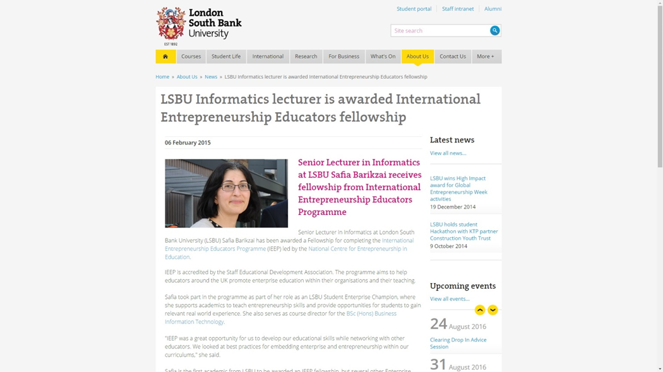
6
of 20
Notes:
CPD underpinned approach
LSBU invested in first enterprise champions: 4 of them took part in IEEP and all new Champions now do this
Develop expertise, grow network, develop practice
Value staff and acknowledgement of their work

Slide 7
7
of 20
Notes:
Some examples: hackathons where students work on real-life business projects
Champion identified curriculum opportunities to embed
Engage students, business community and academics
Chances to apply theory to real world problems
Work with live briefs and clients- not just out of a text book

Slide 8
8
of 20
Notes:
Give students and staff confidence to try new approaches
Staff: refresh content; embed live brief; professional focus
Students: team work; employer-focused; creatively solve problems

Slide 9
9
of 20
Notes:
Project funded by the IPO
Embed IP into the curriculum
Champions influenced new colleagues to take part in project
Engaged over 1,500 students
15 academics developed new curriculum content

Slide 10
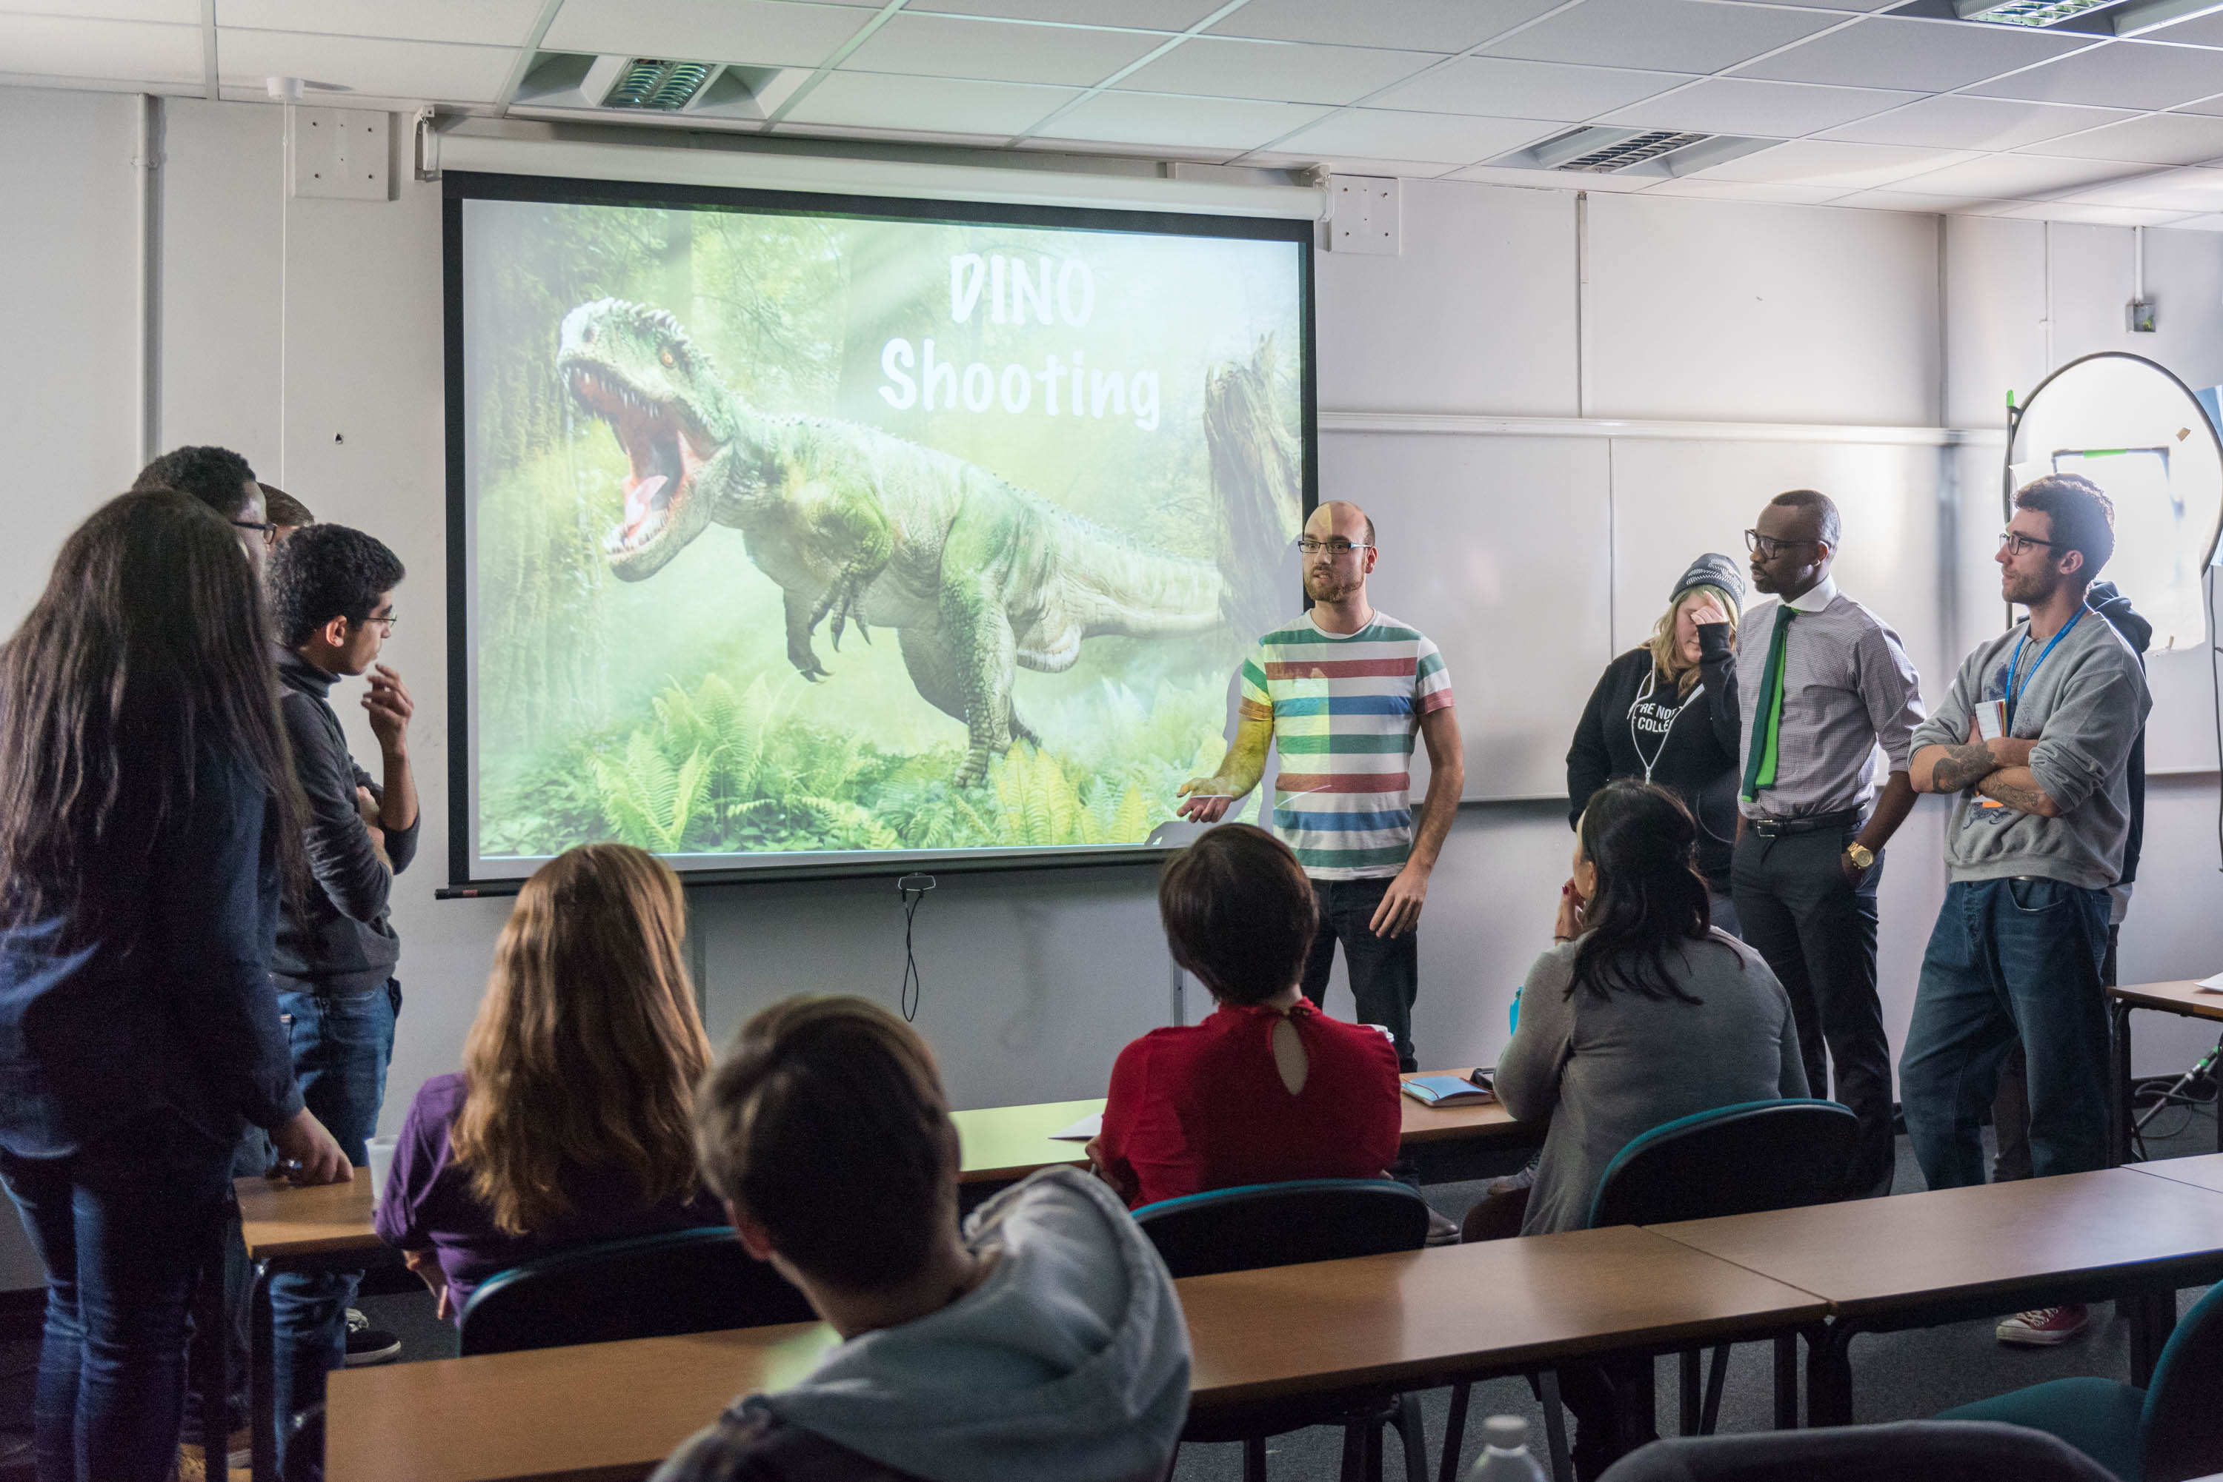
10
of 20
Notes:
Games Jam – interdisciplinary collaboration between IT and Computer Games Design students
IT students acted as consultants to Computer Games Design students in game development
Two day intensive programme
Assessed as part of curriculum – first collaboration between the two areas

Slide 11
11
of 20
Notes:
Business Solutions Centre
Drop in centre run by current LSBU students from Business School
Diagnosis of business problems
Refer onto academic colleagues / mini projects
Led by Enterprise Champion from Business School

Slide 12
12
of 20

Slide 13
13
of 20

Slide 14
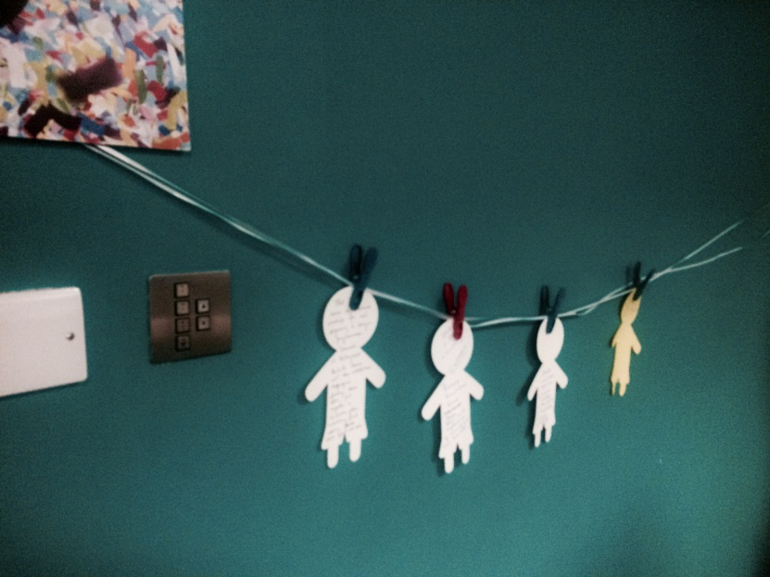
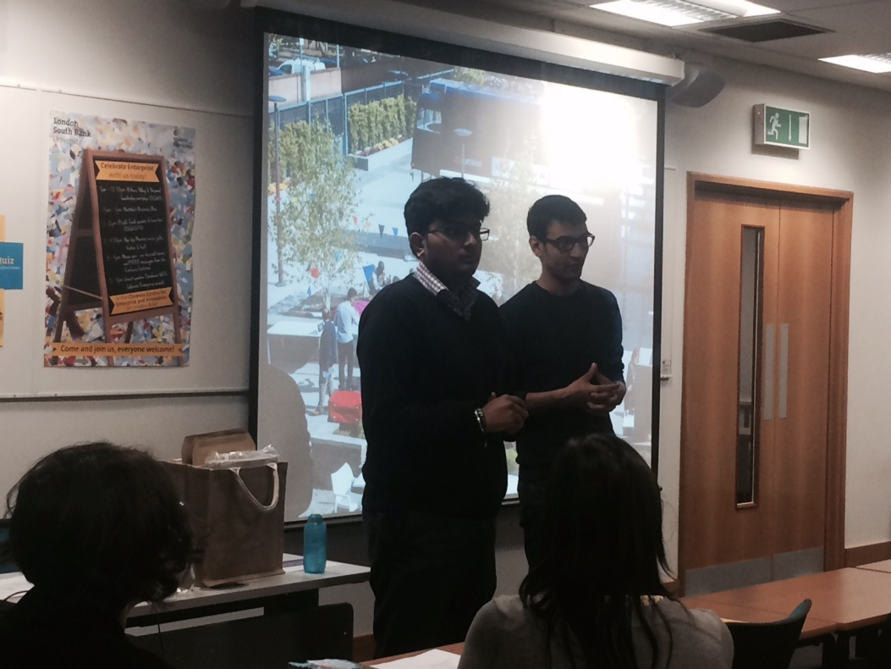
14
of 20
Notes:
Dissemination
- Staff Conference workshops

Slide 15
15
of 20
Notes:
Demonstrating Impact

Slide 16
16
of 20

Slide 17
17
of 20

Slide 18
18
of 20
Notes:
1/3 students engaged with enterprise support – 65 curriculum sessions and +5,000 students engaged

Slide 19
19
of 20

Slide 20
20
of 20

