Slide 1
From Bangor to Bangkok International Innovation in FE/VE
Notes:
Penny

Slide 2
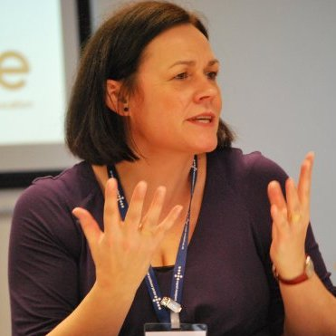
Introductions
Penny Matthews
Suzanne Profit
Lisa McMullan
Notes:
Penny

Slide 3
Overview- How it started
GLLM International Office – building relationships
Tender opportunity – British Council in Thailand
Collaborative approach – building a partnership
Timescales
Networks in place
Notes:
Penny
Timescales – make point about being rushed / these opportunities don’t give much time
Networks – therefore, need to build on networks and connections already in place – what resources can you tap into quickly? Who can you work with? Evolves over time to respond to emerging findings and requirements

Slide 4
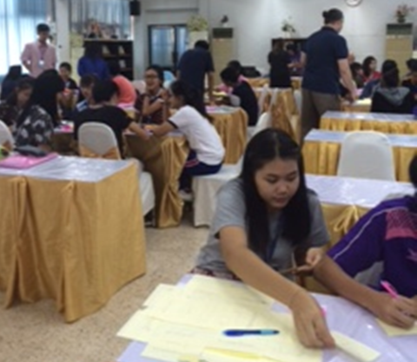
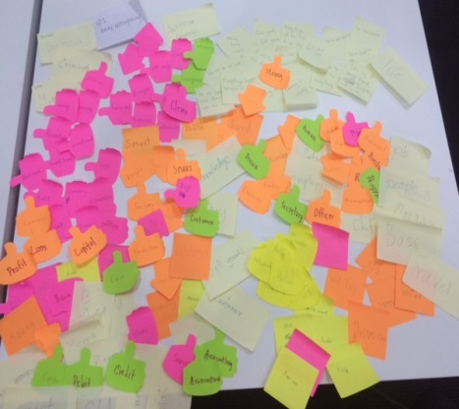
What did we do?
Scoping visit
Stakeholder consultation
Mapping of qualifications
Reporting
Presenting
Educator Workshop
Curriculum Development

Slide 5
What did we find?
National policy commitment
Best practices (institution)
Energy, enthusiasm, expertise (educators)
Difficult to engage / ambition in those that did (students)
Enterprising skills and attributes (entrepreneurs)
Challenges
Notes:
My thinking here is to summarise at different levels:
Policy
Institutional
Educator
Student
Entrepreneur / employer
Slides could be a photo per per slide for each of the groups

Slide 6
What did we learn?
Similar experiences
Cultural differences and understanding
Not to make assumptions
Check understanding . . . .
Importance of fitting local context

Slide 7
Lost in translation
https://play.kahoot.it/#/k/8b915bf2-8a70-43d2-85c5-0285502a31ad
Teams of 4- 6
Phone with internet
Team name
Follow the link and good luck!
Notes:
Suggest we do this first to get a bit of energy in the room – leads from some of our lessons and examples. And have a bit of fun ☺
Like the kahoots tool – works well.
Think we should limit the number of questions to 5 or 6, and to refine wording but love the idea of it.
We could include some relevant to our work – an enterprise / enterprising one – as well as more light hearted ones to show how it can be used . . . .

Slide 8
What does Enterprise mean?

Slide 9
What is Entrepreneurship?

Slide 10
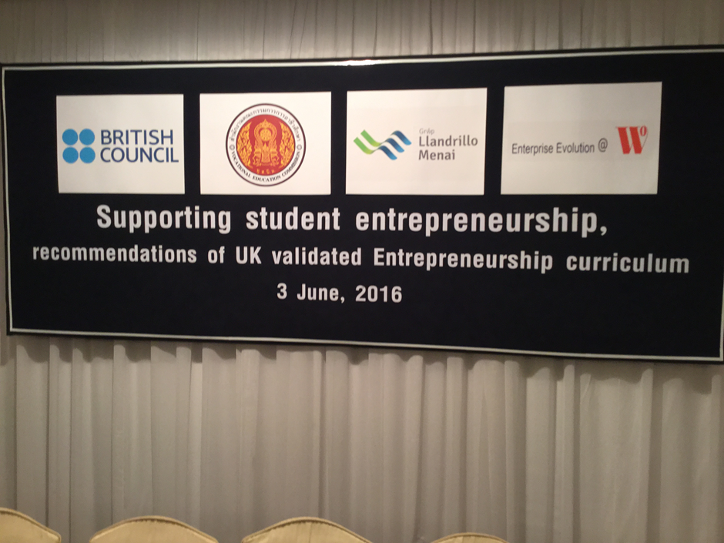
What did we learn?
Notes:
One of the key findings – 6 themes – importance of this

Slide 11
6 new FE/VE themes
UK HE Guidance themes | New FE / VE Themes
Creativity and Innovation | Creativity
2. Opportunity recognition, creation and evaluation | 2. Recognise and develop an opportunity / opportunities
3. Decision making supported by critical analysis and judgement | 3. Demonstrate decision making
4. Implementation of ideas through leadership and management | 4. Build ideas through team work
5. Reflection and Action | 5. Reflection
6. Interpersonal Skills | 6. Interpersonal skills
7. Communication and Strategy Skill

Slide 12
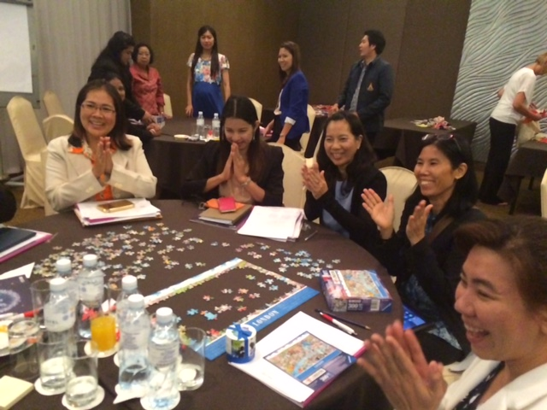
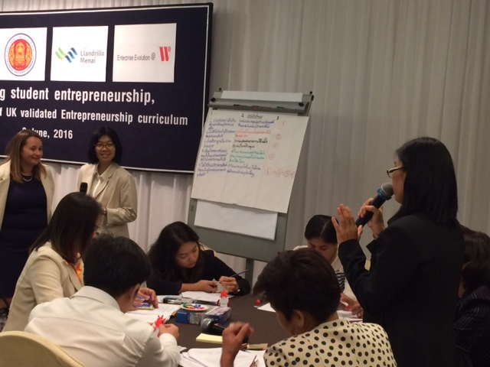
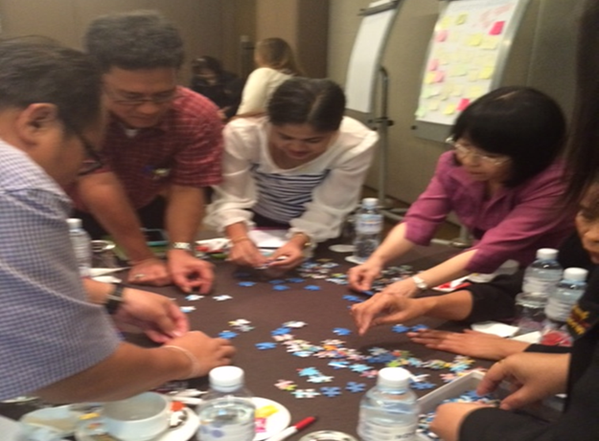

Slide 13
Testing for besting!
International Innovation
Group activity
Look at themes, do you think having FE/VE themes is a useful development?
What about current practise, can you work with these themes?
What do you think? Examples how can apply this?
Notes:
Need to guide the conversation – and ask for specific feedback
Is this a useful development?
How

Slide 14
International Innovation
Reasons to work internationally?
Notes:
Introduce main areas on the menu – things to be considered
Then give out menus and invite colleagues top complete on own or in small groups

Slide 15
Takeaway menu

Slide 16
Thanks!
@bangkokented

