Slide 1
The Transition from Student to Business Owner A journey into the Enterprise Placement Year
Philip Clegg & Catherine McGrath
University of Huddersfield

Slide 2
Learning Outcomes
Gain an understanding of the generic Enterprise Placement Year (EPY) model
Understand development of EPY and how it is evolving with a new innovative model
Understand the context and impact of ‘transition’ in this setting
Engage in a facilitated discussion around the attitudinal challenges and potential solutions
Receive notes circulated following event
NB....
We proposed this session as we don’t know all of the answers!

Slide 3
A Brief Introduction to EPY
An alternative to a traditional placement year for 3rd year undergraduate students
A 10 month programme developed and refined over 9 years
A fully accredited placement degree option
Programme offered across the University of Huddersfield schools wherever traditional 1 year placements are appropriate
A structured programme culminating in business pitch and reflective learning outcomes
Pass/Fail outcome

Slide 4
Introduction to SS EPY
Specific Computer Games Development Company scheme
Unique challenges and different desired outcomes of EPY
Follows EPY programme format with additional elements
Prototype year, 1 holding year, launch
Impact to date

Slide 5
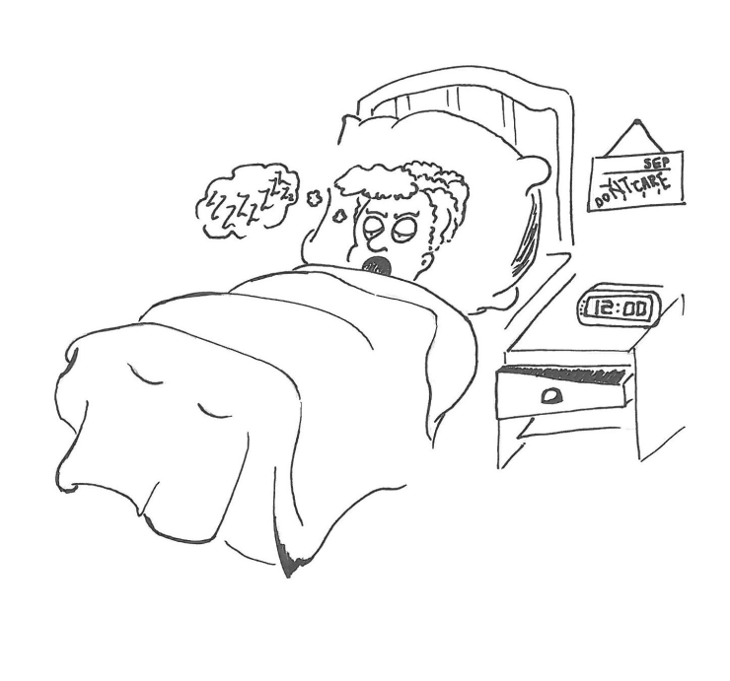
What do we mean by Transition!

Slide 6
Graduate Transition often less dramatic

Slide 7
Induction Day to Welcome Week
Was Induction Day until 2015 – now ‘Welcome Week’ 2016
Programme overview plus Developmental Sessions
External business visit and innovation challenge
Establish peer connections and working pattern

Slide 8
Welcome Week Feedback
Top things learnt:
better time management; better networking skills; it’s good to ask for help; it’s ok to change plans; the importance of preparation; it’s good to share ideas;
And:
Reality of running a business
And:
“A lot of new uses for pipe-cleaners!”

Slide 9
Exercise
There are 4 areas to address
Looking at attitudinal and not just practical solutions
20 minutes to discuss your topic from Students/Enterprise Educator perspective
10 minutes feedback/discussion

Slide 10
Four Transition Challenges
Effective Communication
(e.g. lack of response to emails/invitations etc.)
Embracing peer learning/networking
(Electing to move out of ‘comfort zone’)
Maximising the internal opportunities and resources available
(Not using Business Advisors, internal event attendance)
Engagement with external opportunities
(Competitions, external event attendance, business lead)

Slide 11
Any Questions?

Slide 12
How to contact us
Email us at enterprise@hud.ac.uk
Website www.hud.ac.uk/enterprise
Follow us on Twitter @HudEnterprise
@CleggPhilip
@CMcGMarketing

