Slide 1
Freelancers: supporting students who may not consider themselves an ‘entrepreneur’, ‘small business’ or ‘start-up’
Lydia Wakefield – Education and Training Manager, IPSE
www.ipse.co.uk

Slide 2
Issues and reasons behind this session
70%
2%
51%
What we’ve heard from experienced freelancers
What I’ve heard from students
www.ipse.co.uk
www.ipse.co.uk
www.ipse.co.uk
Notes:
SOC 1-3 Independent professionals – 70% are NQF level 4 or above - Exploring the UK Freelance Workforce – IPSE – 2015
Despite lots of great support actually being available…
2% independent professionals found out about this way of working at university - ComRes Demographic Survey - IPSE in collaboration with ComRes – 2014
51% increase in the number of 18-29 year olds becoming independent professionals

Slide 3
Experienced independent professionals
I’m not an entrepreneur or start-up
I have no intention of taking on employees
I didn’t have any support or advice when I was in education
I change what I call myself depending on who my client is
www.ipse.co.uk
www.ipse.co.uk

Slide 4
Common student phrases
Its just a hobby, I’m not self-employed
I’m just freelancing on the side
Freelancer OR limited company
I don’t have a ‘big idea’
I didn’t know that support was available / available to me
Have you registered as self-employed by registering for self-assessment?
No. I’m just freelancing
www.ipse.co.uk
www.ipse.co.uk

Slide 5
Things to take in to consideration
Terminology and types of self-employment
Information people need to set up and succeed. Does everyone need the same information?
Where and how do students access their information?
www.ipse.co.uk
www.ipse.co.uk
Notes:
Types of growth
Different departments / schools / courses

Slide 6
What’s in a name?
What could self-employed people refer to themselves as? 5 minutes.
Freelancer
Contractor
Consultant
Business-owner
Sole-director
Sole-trader
Self-employed
Start-up
Entrepreneur
Sub-contractor
Working-for-yourself
Running-a-business
Sole-proprietor
Interim
Independent-professional
Founder
Director
Gigger
Nano/Micro–Business
Small-business
www.ipse.co.uk
www.ipse.co.uk
Notes:
Pg 20 of the Exploring UK Freelance Workforce

Slide 7
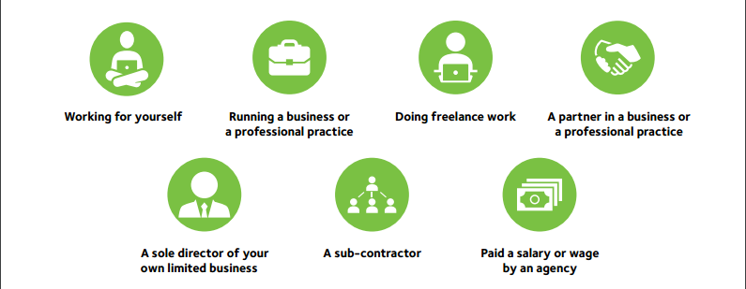
So what do independent professionals call themselves?
www.ipse.co.uk
www.ipse.co.uk
Notes:
‘Working for themselves’ – more than 2/3 – Exploring the UK Freelance Workforce
Occupations can have an impact
Creative more likely to use ‘do freelance work’
Gender impact
‘Sole director’ or ‘running a business’ men more likely
‘freelance work’ or ‘working for self’ female more likely

Slide 8
Activity
Select one type of self-employment
Consider the following:
Information they need
What activities meet these needs?
Is this specific to one subsection of students or self-employed groups?
How would you reach this group?
Which departments would be worth involving?
www.ipse.co.uk
Notes:
Information – set up, money matters, legal, growth, marketing
Activities – talks, workshops, online, guides, delivered by who?
Specific? Depends
How would you reach this group? – Marketing, terminology, clubs, societies, courses, departments
Which departments? - How do these students engage with careers advice?
Products, services, in partnership, freelancing, portfolio, different types of growth (products, services, new geographical markets, new target markets, increasing rates / prices, skills, client base)

Slide 9
Activity - questions
What are the differences and similarities between the information they need?
Targeting different groups of self-employed
What support can be run for all, what needs to be targeted?
Is it worth bringing them together?
What groups are more difficult to reach?
Recognising and promoting different types of self-employed
www.ipse.co.uk
www.ipse.co.uk

Slide 10
QUESTIONS?
www.ipse.co.uk
www.ipse.co.uk

Slide 11
www.ipse.co.uk
Lydia.Wakefield@ipse.co.uk
020 8897 9970 / 07496 638797
www.ipse.co.uk

