Slide 1
Nurturing Women’s Entrepreneurship: perspectives from the UK and GCC
Dr. Najma Taqi – Arab Open University
Dr Safia Barikzai – LSBU
Linsey Cole – LSBU

Slide 2
Overview
Share outcomes of two studies into women’s entrepreneurship
Identify attitudes
Understand the challenges
Comparison between UK and GCC
Share best practice identified
Make pledges for future work to support under-represented groups

Slide 3
London South Bank University

Slide 4
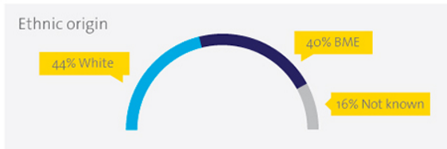
London South Bank University

Slide 5
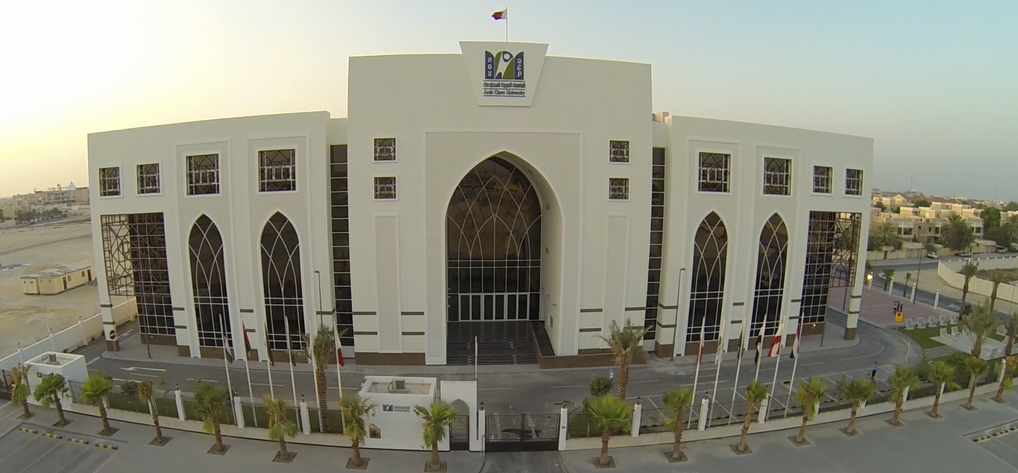
Arab Open University, Bahrain

Slide 6
Arab Open University, Bahrain
1996: Official Opening
HRH Prince Talal Bin Abdulaziz President of the Arab Gulf Development Programme (AGFUND)
2002: AOU strategic partnership with Open University, United Kingdom
Quick Facts:
AOU GCC countries: Jordon, Lebanon, and Egypt.
Headquarter: Kuwait
23000 students
12,000 graduates
50% female graduates

Slide 7
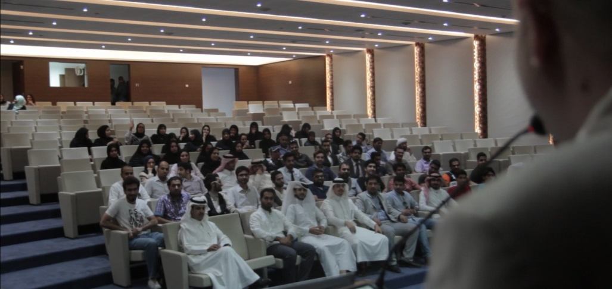
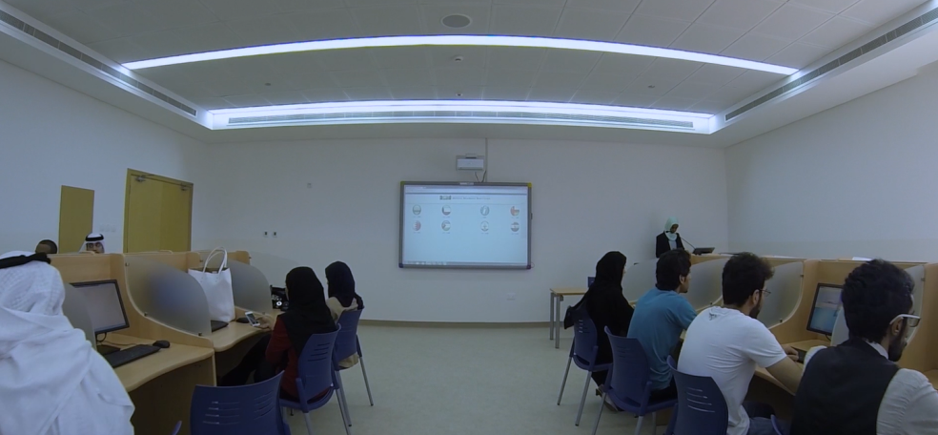
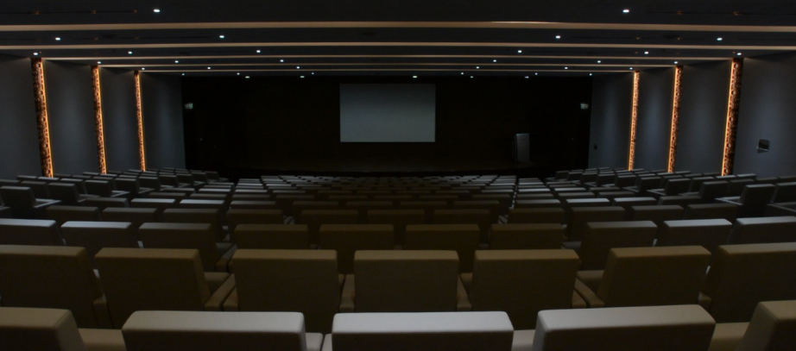

Slide 8
Nurturing Women: Igniting passion for entrepreneurship @LSBU
Funded by Enterprise Education Research Project Fund
Aim: “identify areas where we can increase enterprise and entrepreneurial engagement and in particular to encourage female entrepreneurs at LSBU to take their business ideas further.”
How?
Create bespoke enterprise education interventions that better support under-represented groups at LSBU
Engage students in research activities
Produce a blueprint for engaging female students in entrepreneurship activities
Pilot a sector-specific peer support group

Slide 9
LSBU Activities
1. Identify challenges and barriers for STEM students
Survey
87 students completed the survey (22 females and 65 males)
Response rate of 12%.
Results:
Two thirds were aware of Student Enterprise at LSBU (60%)
Despite the small sub-sample sizes, it was evident that females were less likely to attend SE activities at LSBU than males.
Nearly two thirds would like to run their own business in the future (63%), and interestingly a greater proportion of females than males stated this, 82% compared with 57% respectively.
Three focus groups
Two with engaged female STEM students and one with engaged male STEM students
Valuable insight into importance of role models for female students

Slide 10
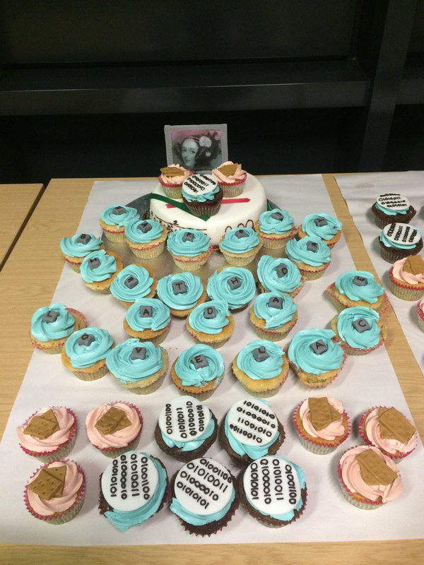
LSBU Activities
2. STEMM Pilot
Focus on the School of Engineering: most marked difference in terms of female/male student ratios.
Delivered activities to raise awareness
IP activities embedded in the curriculum
Birthday celebration for Ada Lovelace (first female programmer)
New interdisciplinary work: Games Jam and a Wellbeing App.

Slide 11
LSBU Activities
3. Developing peer support Entrepreneurs Network
Subject specific networking opportunities: ‘Diversity in Engineering’ event
2016-17:29th October during Black History Month.

Slide 12
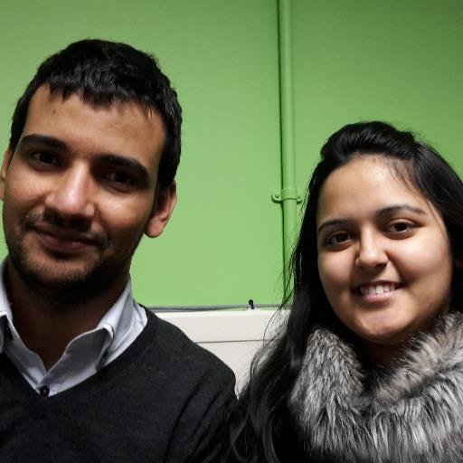
LSBU Activities
4. Raise awareness
Nathu Puri Institute (NPI) aims to ‘be an international centre of excellence for fostering innovation and enterprise in engineering education and practice’.
Secured funding to revamp the Nathu Puri portal summer 2016 with student interns
Interns will:
create enterprise case studies
showcase best practice and promote events with a view to raising awareness of entrepreneurship within the School of Engineering and beyond

Slide 13
LSBU Outcomes
Student engagement in enterprise activities increased: engaged with over 5,000 students (approx. ⅓ of the student population)
Increased proportion of female students taking part in our start-up an accelerator programmes
2015/16, there were 45 participants in our start-up programmes, of which 20 were female (44%).
An increase of 10% when compared to 2014/15.
In 2016/17, first female President of South Bank Entrepreneurs (SBE)

Slide 14
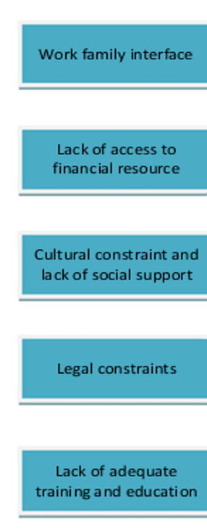
Gulf Cooperation Countries (GCC) Study
Doctoral Study – Quick Facts
Large sample size of female entrepreneurs operating in GCC countries
Survey: 412 women approached, 397 completed online survey
Interviews: 54 consented to interview but only 24 completed
Communications sent by the entrepreneur networks
Almost ALL female entrepreneurs were native to GCC (Support for International entrepreneurs not available at present)
65% of the women were married

Slide 15
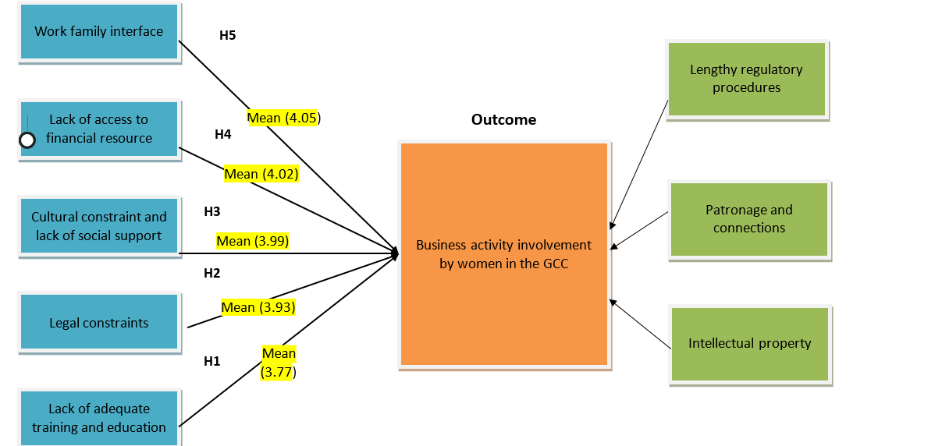
GCC Outcomes

Slide 17
Future Collaborations
UK & Bahrain

Slide 19
Contact us
Dr. Najma Taqi
Najma.taqi@aou.org.bh
Dr Safia Barikzai
safia.barikzai@lsbu.ac.uk
Linsey Cole
l.cole@lsbu.ac.uk

