Slide 1
Welcome
Enterprise Educators UK
6 September 2016

Slide 2
Introductions ….
Maggie Anderson: Lecturer in Entrepreneurship,
Edinburgh Napier University Business School
Susan Laing : Subject Group Leader (Entrepreneurship)
Edinburgh Napier University Business School
Contact details: ma.anderson@napier.ac.uk
(Twitter: @101jasper)
s.laing@napier.ac.uk

Slide 3
Title
Customising the Student Experience – how do we apply this to assessment in an innovative way?
Context of Entrepreneurship Education

Slide 4
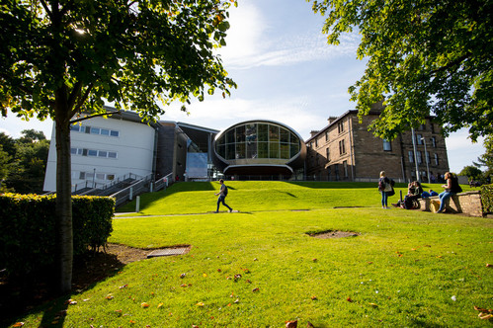
Route Map …
Introduce Edinburgh Napier University and Entrepreneurship @Edinburgh Napier
Customising our Student Experience
Assessment – the Bigger Picture
Assessment –as is @ Edinburgh Napier
Assessment – future
Challenges
Any Questions?

Slide 5
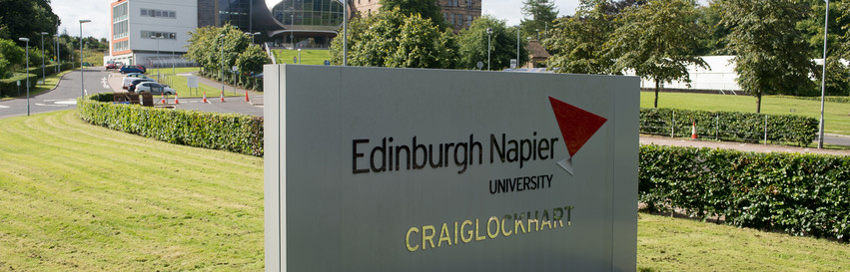
Edinburgh Napier University Overview
VISION 2020
‘An innovative community which is deeply connected to the world around us, working at the leading edge of our academic disciplines in research, pedagogy and professional practice, developing highly valued graduates’.

Slide 8
Edinburgh Napier University Business School
Entrepreneurship Curriculum ..
‘Entrepreneurial learning - academically underpinned, interactively delivered and practically assessed’

Slide 9
Our Curriculum …
Centre for Entrepreneurship established 1995 within the Business School From 2012: Circa 300 students studied BA in Business and Enterprise (BABE) Innovative 1 yr “top up” degree Over 30 students studied Masters in Entrepreneurial Leadership (MEL) – many students are owners of SMEs. 88 students completed combined 1st degrees with Entrepreneurship over last two years Students within the Business School choose the modules as options Subjects such as Business Planning, Creativity, Innovation, Business Growth Highly applied and “For” Entrepreneurship Early BABSON influence on our Teaching and Assessment

Slide 10
Modules
Creativity and Innovation
Introduction to Entrepreneurship
Starting a New Business
Entrepreneurial Consultancy Project
Growth Issues
Strategic Entrepreneurship
Entrepreneurial leadership
Signature Leadership Project

Slide 11
Module and Programme Review led us to reflect
Focus more on For within our Entrepreneurship Curriculum
Undergraduate – fairly standard Assessments:
Business Plans
Business Pitch
Presentations
Reports
University drive for less Assessment overall
Rationalisation of Assessment – hard to be innovative, need more ideas and inputs (ongoing)

Slide 12
Post Graduate – more innovative?
MSc Entrepreneurial Leadership
Students very engaged
Want innovation on such a programme and new ways of approach to learning
Blended programme, so we embraced technology
Assessment: tried to think beyond exams / reports / business plans
Used discussion boards
Real life organisations / their choice
Final assessment instrument – given a choice of 3 methods (equivalents)

Slide 13
Issues with this ….
Quality wanted everyone to submit the same type of assessment, yet acknowledged the equivalencies
LTA back up at the Approval of the Programme
Students liked having a choice – all were post-grad who knew their own strengths and preferences
Most were surprised at being given a choice
All appreciated the alternatives to text –based assessments – which dominated their entire educational experience to date
Most had fine tuned their presentation / video / Camtasia skills via their career – the University didn’t teach these

Slide 14
Assessment @ Edinburgh Napier
Assessment and Feedback Key Principles and Bibliography
Approved by University LTAC November 2015
An emphasis on formative assessment that generates high quality feedback
A reduction in summative assessment
Well defined links between formative and summative assessments, so that feedforward from the former to the latter is clear

Slide 15
Programme Focus …
Mappin​g, sequencing and streamlining assessment varieties within modules and across the programme, so that assessment and feedback is:
Balan​​​​​​ced - Assessment and feedback is appropriately spaced without overloading particular times, modules and levels
Coherent - Modules, and levels of study, complement each other, with the learning from assessments and feedback in each designed to accompany other assessment and feedback in the programme.
Developmental - Assessments and feedback build on previous experiences, with learning pathways through programmes by which students have the chance to experience key assessment types and carry forward the feedback from them to use in similar but increasingly sophisticated or demanding contexts.
Clear - The timings and the types of assessment and feedback are clear to students and staff, as is the rationale underpinning our assessment and feedback design.

Slide 16
Assessment in Higher Education ..
Staff often deterred from innovation in assessment because of Quality protocols (Taras, 2002)
Students often frustrated because learning = pressure of summative grades
Both of these can hinder HE assessment development
Often practice can be “student centred” but not Assessment
Assessment methods are less innovative – heavy reliance on exams and essays (Bloxham and Boyd, 2007)
Focus is on Assessment being the domain of the tutor, not the student
How “customised” can Assessment really be?

Slide 17
Other factors …
Level of student – 1st year students want to pass, 4th years want the grade for their classification
Undergraduate vs Postgraduate approaches – should they be different?
Involvement of stakeholders, not just in the classroom, but in Assessment (Pittaway and Edwards, 2012)
Increased “customised programmes” and student choice – should this extend to type of assessment undertaken?

Slide 18
QAA – the bigger picture

Slide 19
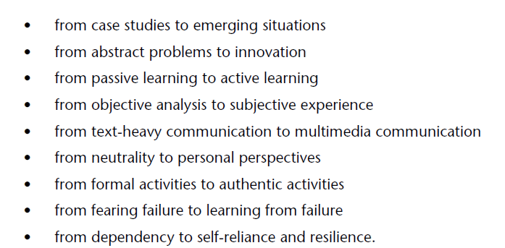
QAA good news….
All very personal and applied, but how easy to translate into Assessments that will pass Quality?

Slide 20
Entrepreneurship Assessment ..
Few studies exploring purely Assessment practice
EEUK and other forums are invaluable for exchange of ideas and help
Drive for innovation by nature, so we can’t help wanting it in our assessments
Often a positivistic approach employed by Businesses Schools (Penaluna, 2009)
Tension exists between the need to assess progress and provide certified public qualifications (Pittaway& Edwards, 2012)
Common classification : For / About / Embedded within Entrepreneurship Education

Slide 21
Challenges…
Entrepreneurship isn’t 1 or 2 subject areas – range great from new ventures, creativity, franchising, corporate entrepreneurship
Assessment appears to be still fairly traditional: Business Plans, Canvas Presentations, Reports for both For and About
Technology has enabled more interactive approaches eg wikis, discussion boards
How can we / should we encourage more stakeholders in Assessments?
Enable more student participation in Assessment – choice and development of- not just token peer Assessment elements

Slide 22
The Future …?
TESTA -

Slide 23
For Discussion ….
How innovative is your assessment practice?
What choices do your students have in Assessment?
How involved are your students / stakeholders in Assessment design?
What are the barriers to being better?
Do you think level matters? Years 1-4 and PG vs UG

Slide 27
Any questions?
Ma.Anderson@napier.ac.uk

