Slide 1
Coaching for Investment Readiness Programme
Philip Clegg
Head of Student & Graduate Business Start-Up
University of Huddersfield
1
of 20

Slide 2
2
of 20

Slide 3
3
of 20

Slide 4
4
of 20

Slide 5
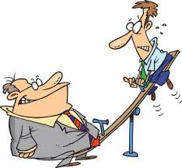
5
of 20

Slide 6
6
of 20

Slide 7
7
of 20

Slide 8
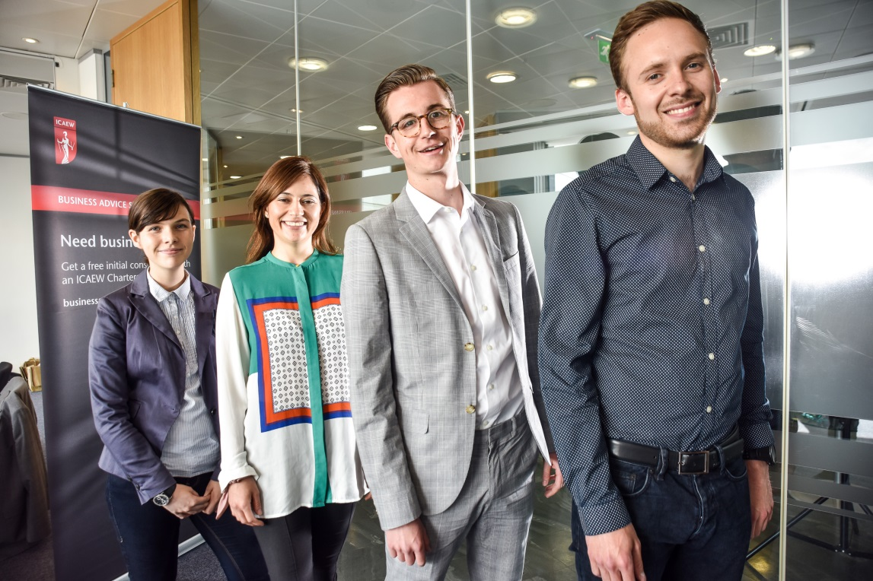
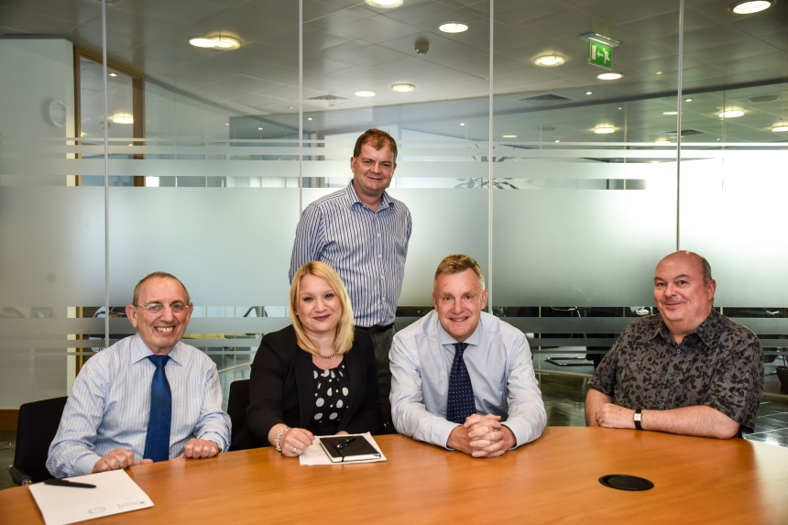
8
of 20

Slide 9
9
of 20

Slide 10
10
of 20

Slide 11
11
of 20

Slide 12
12
of 20

Slide 13
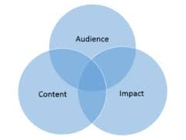
13
of 20

Slide 14
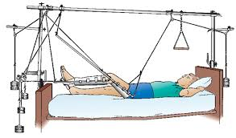
14
of 20

Slide 15
15
of 20

Slide 16
16
of 20

Slide 17
17
of 20

Slide 18
18
of 20

Slide 19
19
of 20

Slide 20
20
of 20

