Slide 1


ECIE 2016
Social Entrepreneurship and Disruptive Innovation: evaluating the use of Rumie’s free educational software in seven developing economies.
Chris Moon, Middlesex University, c.moon@mdx.ac.uk
Allison Kavanagh, RUMIE, allison@rumie.org
Jackie Jeffrey, Well-being foundation, J.Jeffrey@mdx.ac.uk
Joseph Gebbels, Independent expert, josephgeb_11@hotmail.co.uk
Karen Korsgaard. Middlesex University, K.Korsgaard@mdx.ac.uk

Slide 2

CSR Global, founded 2001, provides a range of services including supply chain verification. www.csrglobal.co.uk.
Dr Christopher Moon FRSA FHEA, founder, has consulted to Pfizer, Reuters, BT and Canary Wharf Group; and a host of SMEs.
Chris is a certified and accredited CSR consultant and Social Auditor and has consulted to 23Red (PR company for World Environment Day), GBRW (banking industry consultants) and Carat Computers (supplier to ARM the FTSE listed software company.
CSR has acted as ‘agent’ for Rumie in the Gambia to supply laptops and oversee the field pilot study in school.
CSR Global will similarly act as ‘agent’ to supply Rumie tablets to other schools in west Africa and oversee the verification of the project and evaluation of outcomes.

Slide 3
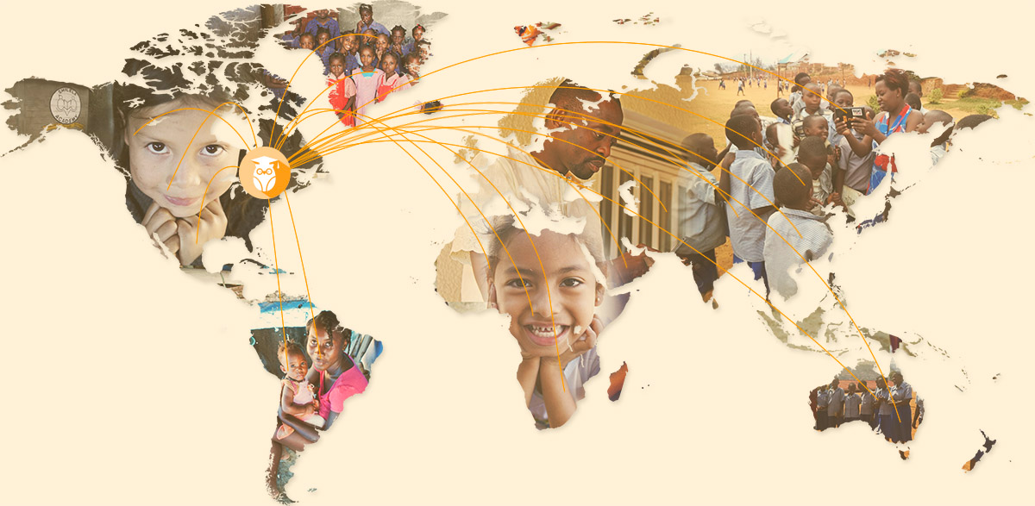
…one billion children across the world living in poverty

Slide 5
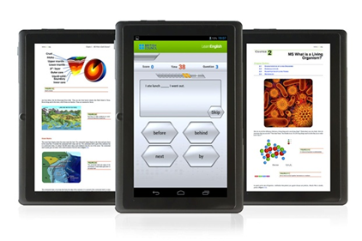
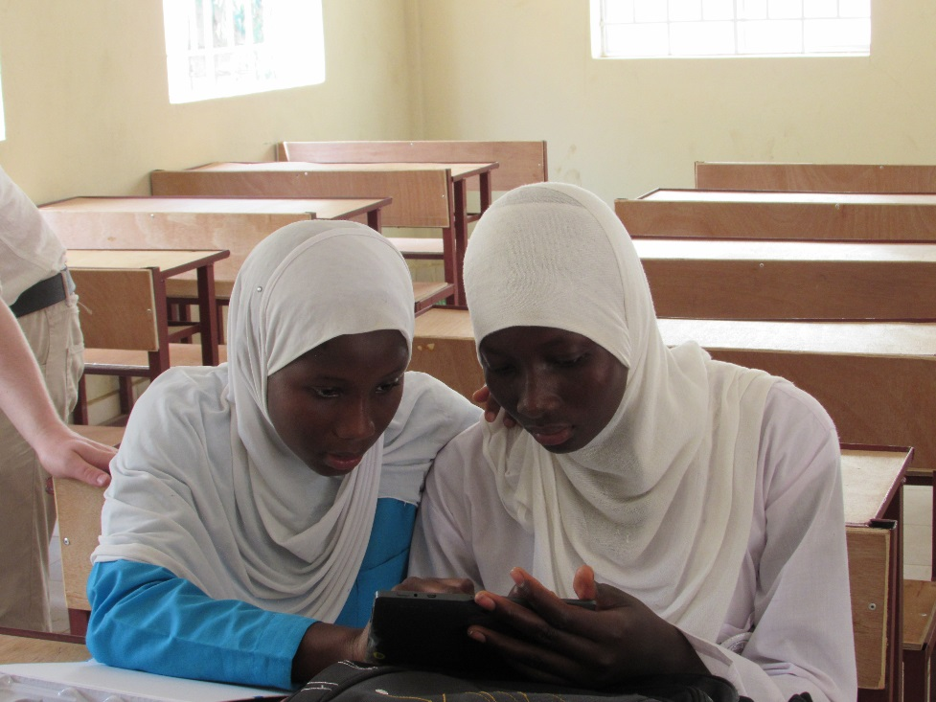
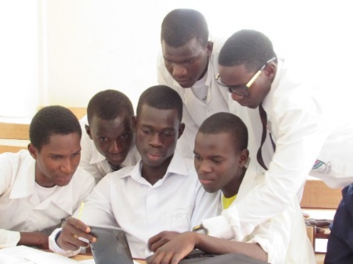
Tablets plus eduware
https://www.youtube.com/watch?v=eealxbCPPeY

Slide 6










Accolades
“WORLD’S BEST SOCIAL STARTUP”
“AN AMAZING STORY”
“THE TABLETS ARE INGENIOUS AND IMPRESSIVE.”

Slide 7


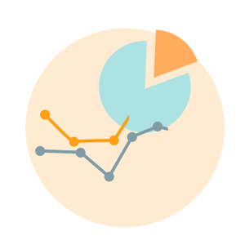
Business model
CHEAPER:
A $50 device preloaded with learning materials that used to cost over $5,000 to produce: innovation that multiplies the value of one dollar by over 100x.
BETTER:
Data analytics and diagnostics mean that devices get better, kids learn more, and impact is measured every step of the way.
FASTER:
Periodic synchronizations allow access to the latest, up-to-date digital learning materials.

Slide 8
Standard content vs. Play section

Slide 9
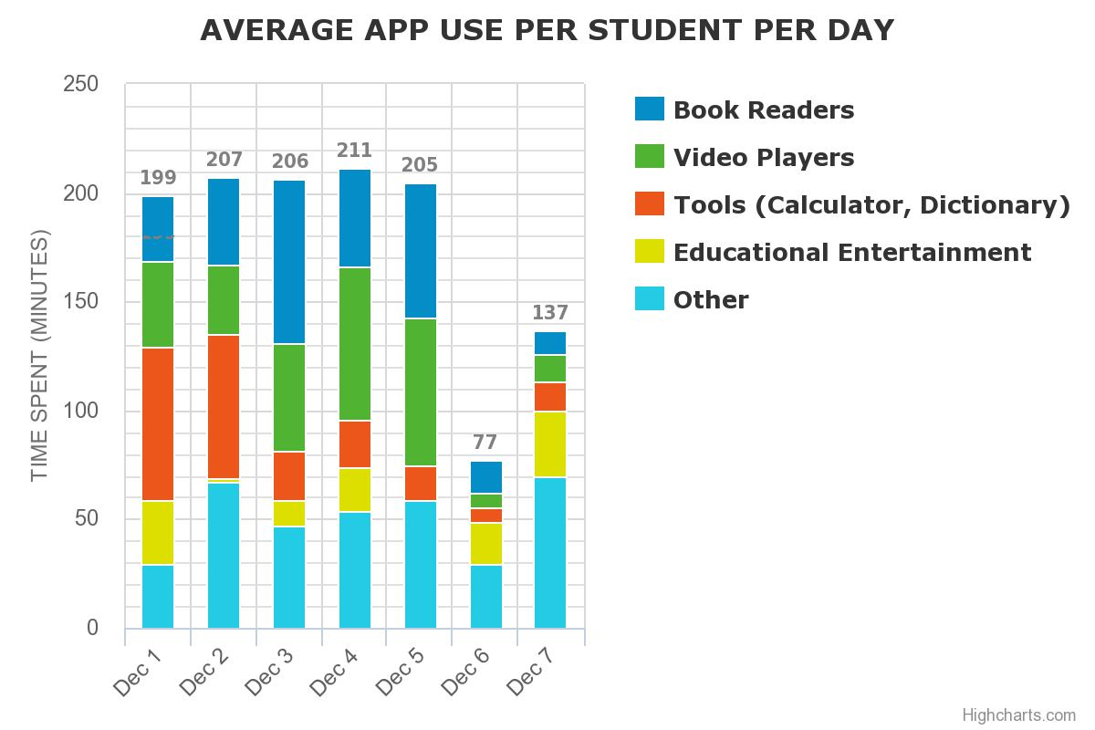
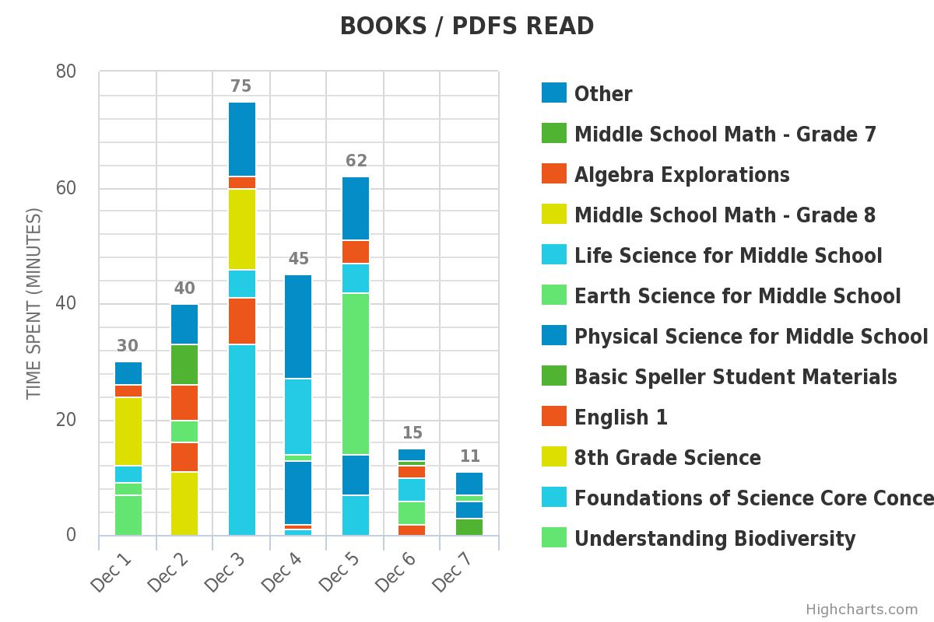
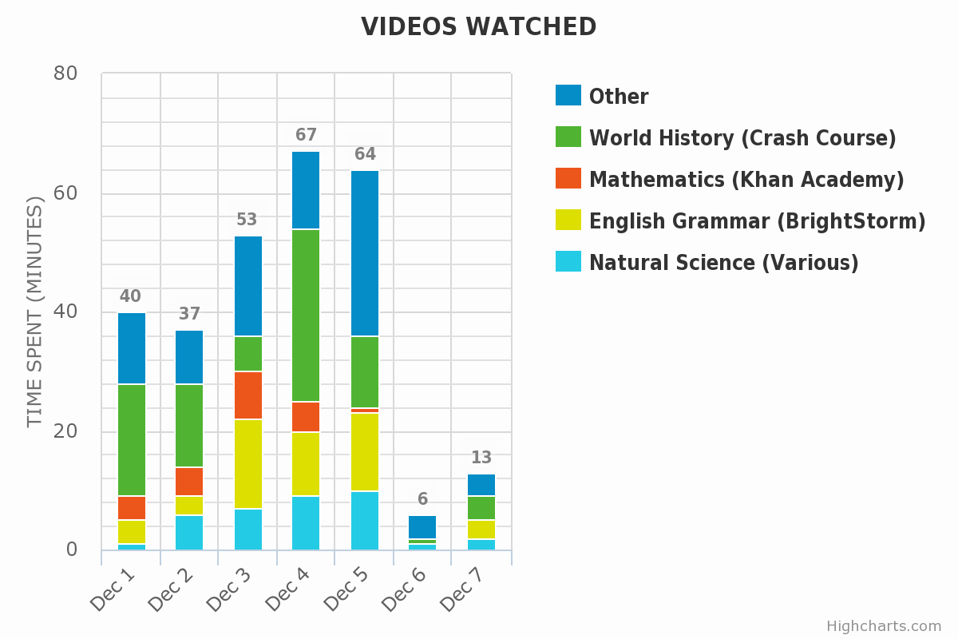
Results – phase 1.

Slide 10
Theoretical background – 2013.
six effective teaching practices:
flexible use of whole-class, group and pair work where students discuss a shared task;
frequent and relevant use of learning materials beyond the textbook;
open and closed questioning, expanding responses, encouraging student questioning;
demonstration and explanation, drawing on sound pedagogical content knowledge;
use of local languages and code switching;
planning and varying lesson sequences.
although not all of these needed to be simultaneously present.

Slide 11
Theory building
Disruptive innovation. Founded on the theories of Harvard professor Clayton M. Christensen (ranked as the #1 management thinker globally in the Thinkers 50 ranking).
cf. Christensen, The Innovator’s Dilemma, 1997.
In May 2015, the Christensen Institute highlighted Rumie as an example of a disruptive technological innovation.
cf. Thomas, The Economics of Educational Nonconsumption in the Developing World, 2015.

Slide 12
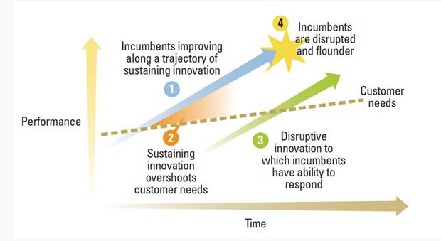
Theory testing
Figure 1. Four Elements of the Theory of Disruptive Innovation, King and Baatartogtokh, 2015.

Slide 13


The future of learning?

Slide 14
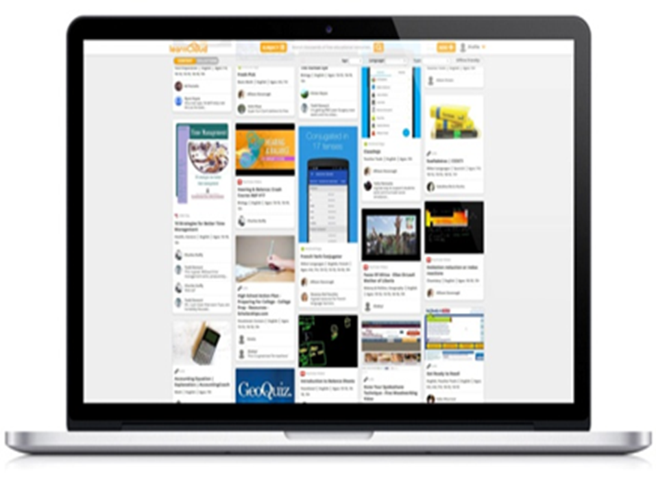
LearnCloud
…the Rumie LearnCloud: the world’s largest crowdsourced open repository of free learning content.

Slide 15
Phase 2. Developing bespoke content e.g. an App (Health).

Slide 16
WHO – school health and youth health promotion
An effective school health programme can be one of the most cost effective investments a nation can make to simultaneously improve education and health. WHO promotes school health programmes as a strategic means to prevent important health risks among youth and to engage the education sector in efforts to change the educational, social, economic and political conditions that affect risk.

Slide 17
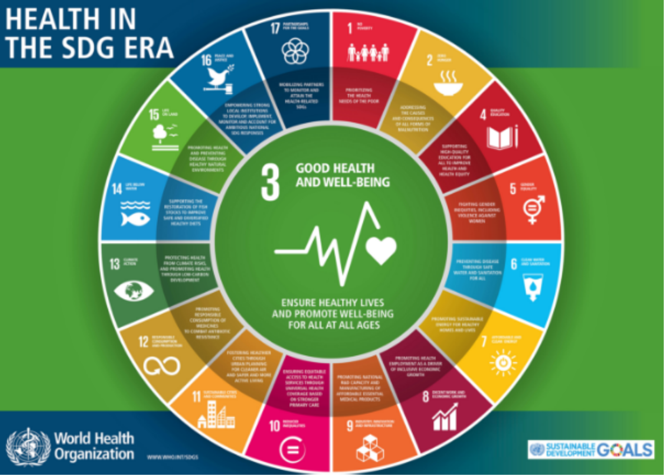
Phase 2. Developing bespoke content. App (Health), cont’d.

Slide 20
App (Health) content or process? Case example 1.
Children Solving Problems: Participatory Epidemiology in Bolivia
Bolivian students aged 8–12 are often caretakers for their younger brothers and sisters. To develop their understanding of health issues, third-grade teachers asked students to make a calendar and record for 30 days the health of a sibling, cousin, or neighbour who was under five years old. If the child was well, they drew a smiling face. If the child was ill, they drew a frown and wrote underneath why the child was ill. At the end of 30 days, the teacher reviewed the calendars, analyzed the information, and invited district personnel into the classroom to discuss ways in which older children, families, and schools could respond. These activities built children’s skills in gathering information and applying math and reasoning skills, as well as their perception of themselves as active participants in their family’s health status.

Slide 21
Case example 2.
Children Versus Mosquitoes
Mosquitoes that transmit dengue thrive in rubbish dumps. So leaders at the Lawrence T. Gay Memorial Primary School in St. Michael, Barbados, set this goal: Reduce the amount of garbage left for daily collection. Adopting the theme “Reduce, Recycle, and Reuse”, the school set apart plastics, paper, and non combustibles. Combustible materials were incinerated and the ashes were applied to the garden beds as fertiliser. Plastic drink bottles were reused as vases, aquaria, candle holders in the crafts programme, and funnels in the school garden.
Students assumed the role of health inspector, searching their surroundings and looking for mosquito-breeding places, collecting larvae for study, informing the local authorities, and eliminating breeding sites. Parents reported that their children had taught them some new habits at home. District public health inspectors arranged visits to the local neighbourhood. They gave the students first hand knowledge of healthy practices and instructed the janitor and school-meals staff about vector control and safe food-handling methods. In addition, the school integrated health concepts and strategies with social studies, mathematics, and agricultural science, and encouraged pupils to express themselves through art, poetry, composition, and craft.

