Slide 1
[IEEC 2016] International Enterprise Education Conference Liverpool John Moore’s University 7-9 September
Dr Dale Heywood
University of Liverpool
Management School

Slide 2
International partnerships – easier said than done without senior management support!
Today we will investigate:-
Why international partners matter more than ever before – Impact?
Network mapping
Funding mapping
What you want to partner on…

Slide 3
EEUK MEMBER’S DISAPPOINTMENT TURNS TO INTERNATIONAL OPPORTUNITY
Read it for yourselves…
Basically I was in the right place at the right time to answer a plea from the largest University in Uruguay for enterprise education help [UdelaR]
http://www.enterprise.ac.uk/index.php/news/item/559-eeuk-member-s-disappointment-turns-to-international-opportunity

Slide 4
SPACE Project with UdelaR, Uruguay
Funded by British Embassy, Foreign & Commonwealth Office to help Faculty of Engineering, UdelaR promote enterprise education
I took a colleague over to Montevideo for 1 week, Feb 2016
I gave a full 6 days of workshops, lectures, networking evenings, lunches, dinners, outreach with SME’s and interviews with the Press
UdelaR = 100,000 students
UoL = 25,000 students

Slide 5
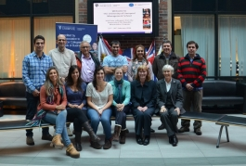
Then brought 12 of them home with me…

Slide 6
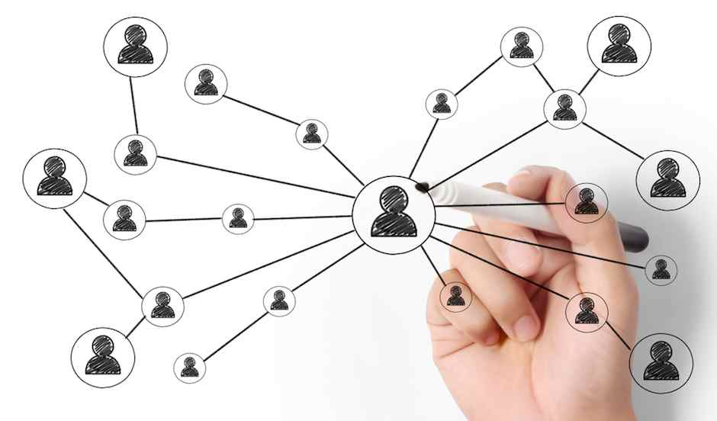
Let’s go old-school…

Slide 7
Pen and Paper exercise
Spend the next 15 minutes mapping your network

Slide 8
Digital tools…

Slide 9
Funding network monitoring

Slide 10
Know your objectives
Why do you want to make international contacts?
Education – Research – Profile – Job Opportunities – Personal Reason?
Do you know what YOU have to offer a partner?
What’s your USP?
What is your institutions USP?

Slide 11
Senior management support?
At UoL have had a new VC and a new Head of School in the past few years [both female ☺]
We are all in a REF Cycle….. It’s all I hear about…
I am an entrepreneurship EDUCATOR… so what about the TEF Cycle?
These are disturbing conflicting agendas

Slide 12
IMPACT!
Now at least I can put together a fairly strong Impact Case Study from my ongoing relationship with UdelaR, Uruguay
We are already working on a second project focussing on Technology Transfer = Christmas in the sunshine!
Formulating a ‘formal international partnership’ however is incredibly bureaucratic and takes many years to complete I have been told.
“What’s in it for us” comes up often
Student exchanges? Staff exchanges? Research collaborations?
All of the above…

Slide 13
Lessons learned
Be alert to both networks opportunities and funding opportunities
If in doubt make an application anyway – often!
Sometimes keeping below the radar is the best way to get things done
Tackle senior management resistance with more success – especially in bringing in funding [£140K this year so far]
Use existing relationships with overseas colleagues to YOUR best advantage regardless of high level support

Slide 14
Moving Forward
Nurture your network
Professor Norris Kruegar and I are working on something because he also went to UdelaR this year and there is very little published about entrepreneurship or enterprise in Uruguay compared to other Latin American countries.
We aim to change that!
The Director of the Newton Fund, Mexico is a personal friend [MBA 2004]
Liliana Carral invites me to apply regularly.

Slide 15
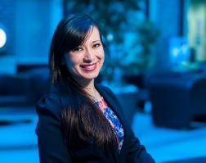
Lízbeth Mariánn Zumárraga Avila - MSc Entrepreneurship 2013-14
Newton Fund application UK-MX
Currently heads Start-up Mexico in Merida which is Mexico’s first entrepreneurial super hub.
Lizbeth now teaches Marketing and Entrepreneurship at Universidad Autónoma de Yucatán (UADY) which is a top 25 graduate university in the south of Mexico.

