Slide 1
Help! I need to assess Innovation and Creativity
Andy Penaluna, Louise Drake & Kathryn Penaluna
International Institute for Creative Entrepreneurial Development (IICED), UWTSD
Royal Society for the encouragement of Arts, Manufactures and Commerce (RSA)

Slide 2
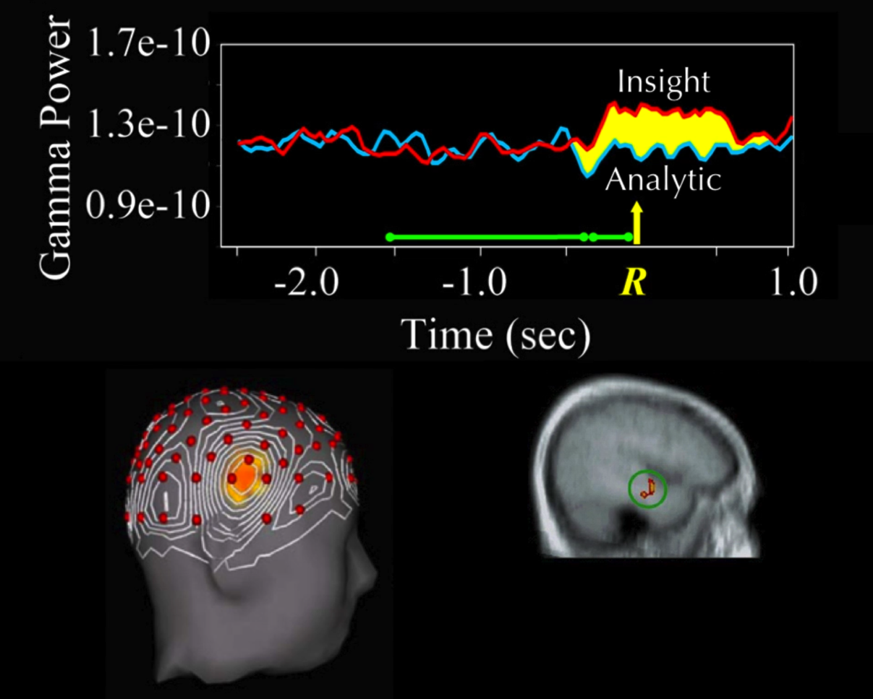
Did you know that:
Your brain works differently when solving problems creatively?
Cognitive styles =
Insight
Analytic
Image courtesy of John Kounios - Drexel and UWTSD ‘Learning for Innovation Week’

Slide 3
You know that feeling:

Slide 4
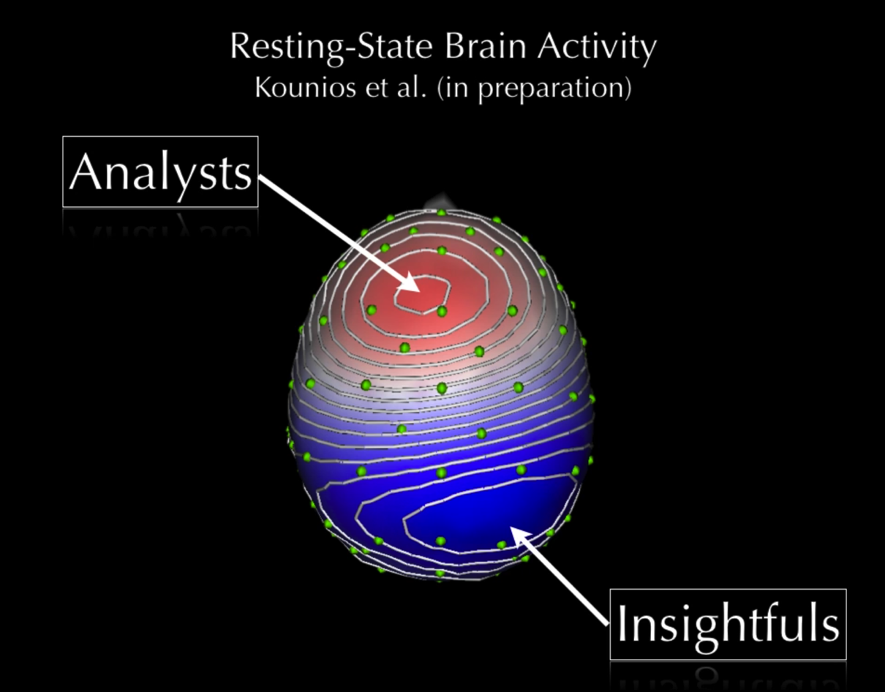
Did you know that:
That recognition and reward mechanisms may significantly impact on your learners’ capacity to develop such brain power?
So assessment matters!
Image courtesy of John Kounios - Drexel and UWTSD ‘Learning for Innovation Week’

Slide 5
Understanding creative thinking
DOG
Extract Courtesy of John Kounios - Drexel and UWTSD ‘Learning for Innovation Week’

Slide 6
Understanding creative thinking

Slide 7
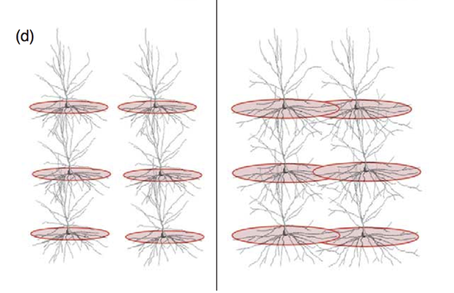
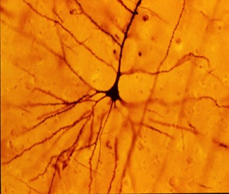
The innovative thinking brain structure
Key point – Developing synapse potential through learning
Detail of Pyramid neuron from the amygdala / hippocampus
Left Cortex
dominance
Right Cortex
dominance
Micro molecular structure images courtesy of Mark Jung Beeman and John Kounios, Mid Western and Drexel Universities
Penaluna & Penaluna 2009

Slide 8
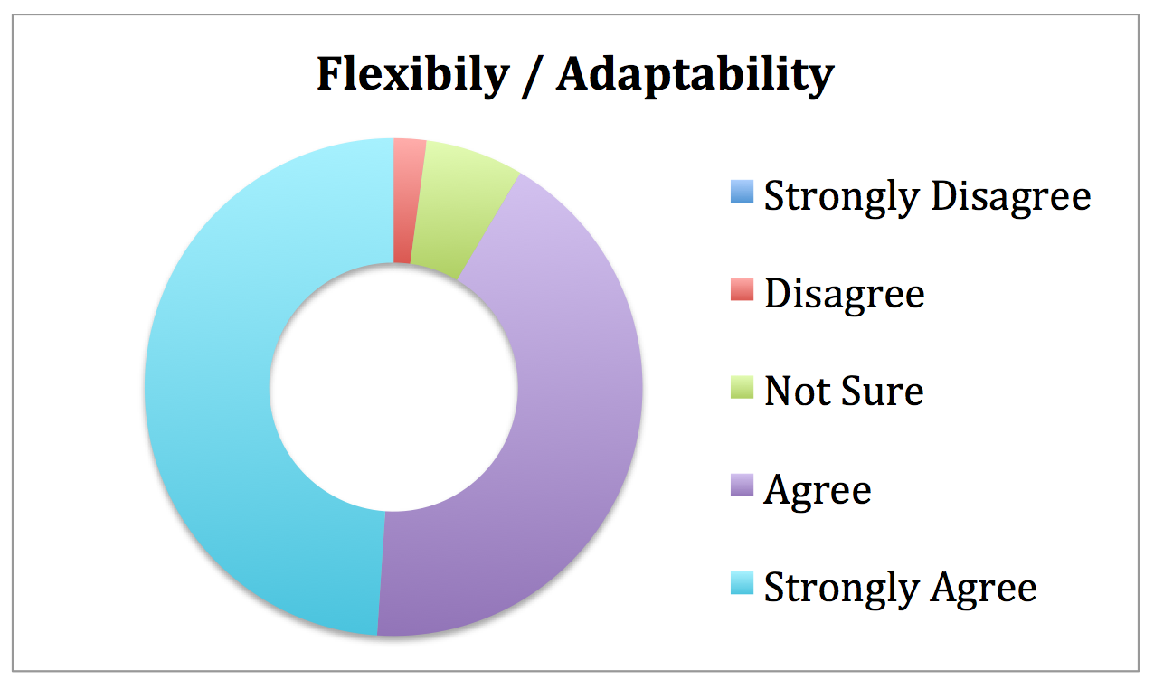
Alumni surveys, e.g. helping students to be more flexible and adaptable by shifting deadlines and adding information iteratively
Strongly Disagree = 0

Slide 9
Beyond education?
Within real entrepreneurial environments we can anticipate re-learning, unlearning, re-evaluating and repositioning… according to shifting scenarios and contexts.
Opportunity recognition, flexibility and adaptability cannot be learned within (what the student perceives as) carefully pre- constructed / pre-prescribed learning environments; they need to evolve within practice based /experiential learning which is meaningfully evaluated in order to reward performance. Here we can anticipate ‘constructive misalignment’ (Scott et. al., 2015 & 2016)

Slide 10
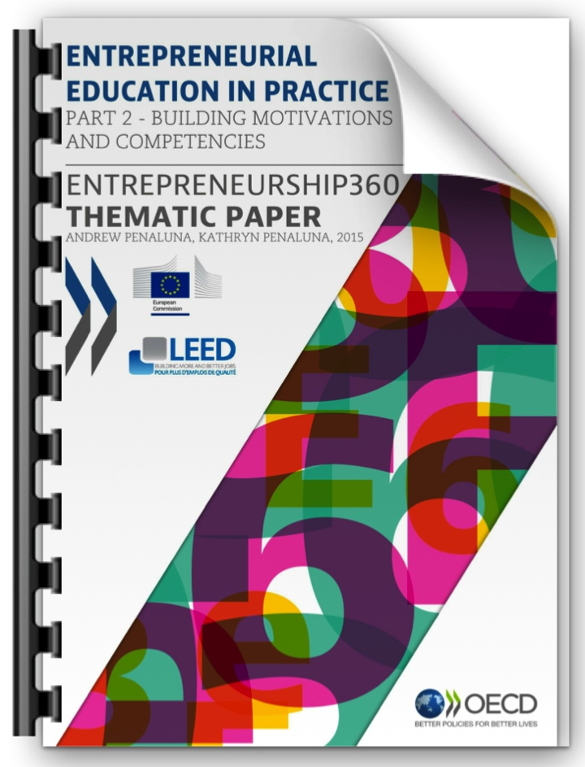
‘I’ in assessment is for?
If detailed and predefined learning outcomes are used they test one ‘I’ – the ability to ‘Implement’… what is is needed to evaluate the other ‘I’ – Innovation?

Slide 11
Making distinction between the two I’s
Implementation
Doing things that are determined by others and matching against their expectations
Innovation
Producing multiple and varied solutions that respond to change and often surprise

Slide 12
Making distinction between the two I’s
Implementation
Can the student come up with a good idea?
Innovation
Can the student come up with multiple ideas that respond to changing circumstances?

Slide 13
Making distinction between the two I’s
Implementation
Can the solution be easily compared and contrasted to previous work and understandings?
Innovation
Does the solution offer new insights and potentially challenge accepted understandings?

Slide 14
Creative Mindsets. Entrepreneurial Futures –
EXTRA EXTRA READ IT ALL ABOUT IT…
Penaluna, A. and Penaluna, K. 2015. Entrepreneurial Education in Practice, Part, 2 – Building Motivations and Competencies, Entrepreneurship 360 Thematic Paper, Organisation for Economic Co-operation and Development (OECD) and the European Commission (DG Education and Culture).
Penaluna, A., Penaluna, K and Diago, I., 2014. The Role of Creativity in Entrepreneurship Education. Chapter 13, “Handbook of Research on Entrepreneurship and Creativity” Sternberg, R & Krauss, G. (Eds) Cheltenham / Northampton MA: Edward Elgar Publishing Limited
Penaluna, K. Penaluna, A., Usei, C. and Griffiths, D. 2015. Enterprise Education Needs Enterprising Educators: A Case Study on Teacher Training Provision, Education +Training, Emerald, Vol 57, 8/9, 948-963
Penaluna K., Penaluna A., Jones C. and Matlay H., 2014. When did you last predict a good idea? Exploring the case of assessing creativity through learning outcomes. Industry & Higher Education, Vol. 28, No 6, December 2014, pp. 399-410.
How education can build creative and
entrepreneurial mindsets

